Slide 1
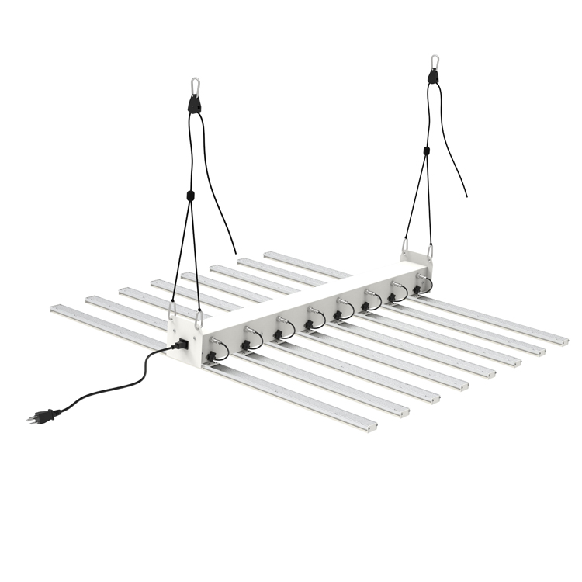
GL01
Led Grow Light
Input Voltage:100-277V AC, 50/60 Hz
Material:Aluminum
LED driver brand：MEANWELL
Power factor：>90%
Led Chip:Epistar + LEDSTAR
Warranty:3 Years
Lifespan:50000Hours
Item Number | Wattage | Led Quantity | Luminous Flux | Beam Angle
GL01 | 320W | 2.7umol/j | Full spectrum | L522mm* W1152mm
 | 480W | 2.7umol/j |  | L1190mm* W1152mm
 | 640W | 2.7umol/j |  | L1190mm* W1152mm
 | 800W | 2.7umol/j |  | L1190mm* W1152mm
Modern Ceiling Light Material:Iron base+ PMMA Cover Input Voltage:AC85-265V Led Chip:2835SMD IP Rating:IP44 CRI>80 PF>0.9 Color Temperature:3000K/4500K/6000K Operating Temperature:-25℃ ~50℃ Life Span:50000hours Certificate:CE ROHS
Item Number | Wattage | LedQuantity | LuminousFlux | Beam Angle | Size (mm) | WIFI Control Remte control Switch control Dimmer control
CL-N00 | 24W | 48pcs2835SMD | 1920-2160lm | 120° | 350mm | Yes
 | 36W | 72pcs2835SMD | 2880-3240lm | 120° | 400mm
 | 40W | 80pcs2835SMD | 3200-3600lm | 120° | 450mm
Modern Ceiling Light Material:Iron base+ PMMA Cover Input Voltage:AC85-265V Led Chip:2835SMD IP Rating:IP44 CRI>80 PF>0.9 Color Temperature:3000K/4500K/6000K Operating Temperature:-25℃ ~50℃ Life Span:50000hours Certificate:CE ROHS
Item Number | Wattage | LedQuantity | LuminousFlux | Beam Angle | Size (mm) | WIFI Control Remte control Switch control Dimmer control
CL-N00 | 24W | 48pcs2835SMD | 1920-2160lm | 120° | 350mm | Yes
 | 36W | 72pcs2835SMD | 2880-3240lm | 120° | 400mm
 | 40W | 80pcs2835SMD | 3200-3600lm | 120° | 450mm
Modern Ceiling Light Material:Iron base+ PMMA Cover Input Voltage:AC85-265V Led Chip:2835SMD IP Rating:IP44 CRI>80 PF>0.9 Color Temperature:3000K/4500K/6000K Operating Temperature:-25℃ ~50℃ Life Span:50000hours Certificate:CE ROHS
Item Number | Wattage | LedQuantity | LuminousFlux | Beam Angle | Size (mm) | WIFI Control Remte control Switch control Dimmer control
CL-N00 | 24W | 48pcs2835SMD | 1920-2160lm | 120° | 350mm | Yes
 | 36W | 72pcs2835SMD | 2880-3240lm | 120° | 400mm
 | 40W | 80pcs2835SMD | 3200-3600lm | 120° | 450mm
Modern Ceiling Light Material:Iron base+ PMMA Cover Input Voltage:AC85-265V Led Chip:2835SMD IP Rating:IP44 CRI>80 PF>0.9 Color Temperature:3000K/4500K/6000K Operating Temperature:-25℃ ~50℃ Life Span:50000hours Certificate:CE ROHS
Item Number | Wattage | LedQuantity | LuminousFlux | Beam Angle | Size (mm) | WIFI Control Remte control Switch control Dimmer control
CL-N00 | 24W | 48pcs2835SMD | 1920-2160lm | 120° | 350mm | Yes
 | 36W | 72pcs2835SMD | 2880-3240lm | 120° | 400mm
 | 40W | 80pcs2835SMD | 3200-3600lm | 120° | 450mm

Slide 2
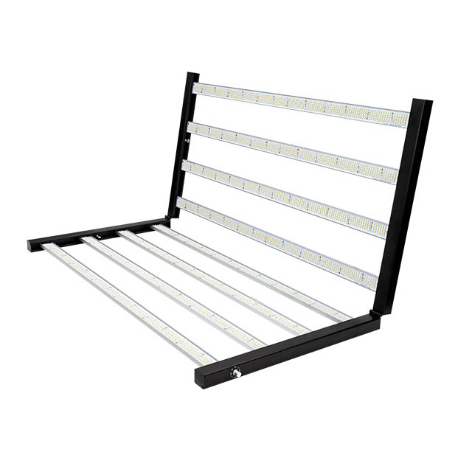
GL02
Led Grow Light
Input Voltage:100-277V AC, 50/60 Hz
Material:Aluminum
LED driver brand：MEANWELL
Power factor：>90%
Led Chip:Epistar + LEDSTAR
Warranty:3 Years
Lifespan:50000Hours
Item Number | Wattage | Led Quantity | Luminous Flux | Beam Angle
GL02 | 600W | 2.6umol/j | Full spectrum | 1184*1143*29
 | 720W | 2.8umol/j | Full spectrum | 1184*1143*29
 | 800W | 3.0umol/j | Full spectrum | 1184*1143*29
 | 1000W | 3.2umol/j | Full spectrum | 1184*1143*29
Modern Ceiling Light Material:Iron base+ PMMA Cover Input Voltage:AC85-265V Led Chip:2835SMD IP Rating:IP44 CRI>80 PF>0.9 Color Temperature:3000K/4500K/6000K Operating Temperature:-25℃ ~50℃ Life Span:50000hours Certificate:CE ROHS
Item Number | Wattage | LedQuantity | LuminousFlux | Beam Angle | Size (mm) | WIFI Control Remte control Switch control Dimmer control
CL-N00 | 24W | 48pcs2835SMD | 1920-2160lm | 120° | 350mm | Yes
 | 36W | 72pcs2835SMD | 2880-3240lm | 120° | 400mm
 | 40W | 80pcs2835SMD | 3200-3600lm | 120° | 450mm
Modern Ceiling Light Material:Iron base+ PMMA Cover Input Voltage:AC85-265V Led Chip:2835SMD IP Rating:IP44 CRI>80 PF>0.9 Color Temperature:3000K/4500K/6000K Operating Temperature:-25℃ ~50℃ Life Span:50000hours Certificate:CE ROHS
Item Number | Wattage | LedQuantity | LuminousFlux | Beam Angle | Size (mm) | WIFI Control Remte control Switch control Dimmer control
CL-N00 | 24W | 48pcs2835SMD | 1920-2160lm | 120° | 350mm | Yes
 | 36W | 72pcs2835SMD | 2880-3240lm | 120° | 400mm
 | 40W | 80pcs2835SMD | 3200-3600lm | 120° | 450mm
Modern Ceiling Light Material:Iron base+ PMMA Cover Input Voltage:AC85-265V Led Chip:2835SMD IP Rating:IP44 CRI>80 PF>0.9 Color Temperature:3000K/4500K/6000K Operating Temperature:-25℃ ~50℃ Life Span:50000hours Certificate:CE ROHS
Item Number | Wattage | LedQuantity | LuminousFlux | Beam Angle | Size (mm) | WIFI Control Remte control Switch control Dimmer control
CL-N00 | 24W | 48pcs2835SMD | 1920-2160lm | 120° | 350mm | Yes
 | 36W | 72pcs2835SMD | 2880-3240lm | 120° | 400mm
 | 40W | 80pcs2835SMD | 3200-3600lm | 120° | 450mm
Modern Ceiling Light Material:Iron base+ PMMA Cover Input Voltage:AC85-265V Led Chip:2835SMD IP Rating:IP44 CRI>80 PF>0.9 Color Temperature:3000K/4500K/6000K Operating Temperature:-25℃ ~50℃ Life Span:50000hours Certificate:CE ROHS
Item Number | Wattage | LedQuantity | LuminousFlux | Beam Angle | Size (mm) | WIFI Control Remte control Switch control Dimmer control
CL-N00 | 24W | 48pcs2835SMD | 1920-2160lm | 120° | 350mm | Yes
 | 36W | 72pcs2835SMD | 2880-3240lm | 120° | 400mm
 | 40W | 80pcs2835SMD | 3200-3600lm | 120° | 450mm

Slide 3
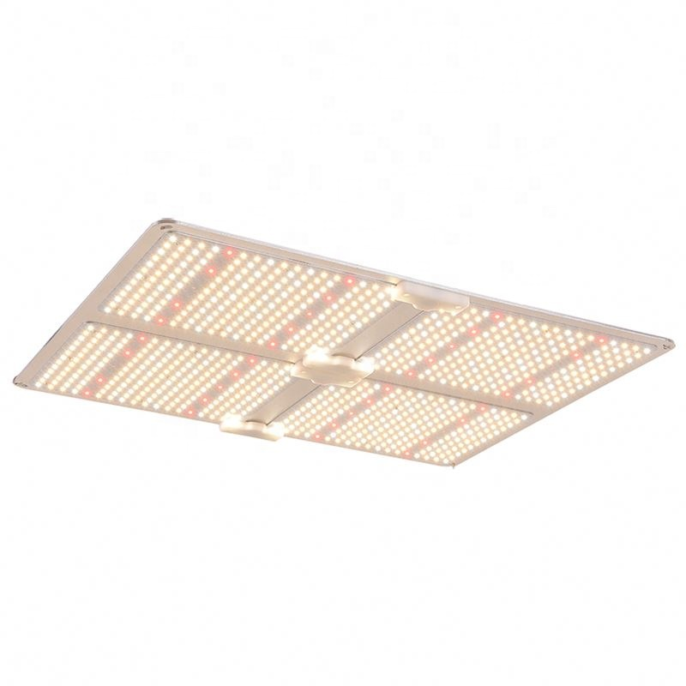
GL03
Led Grow Light
Input Voltage:100-277V AC, 50/60 Hz
Material:Aluminum
LED driver brand：MEANWELL
Power factor：>90%
Led Chip:Epistar + LEDSTAR
Warranty:3 Years
Lifespan:50000Hours
Item Number | Wattage | Led Quantity | Luminous Flux | Beam Angle
GL03 | 100W | 2.7umol/j | Full spectrum | 300*240*55
 | 220W | 2.7umol/j |  | 600*240*55
 | 450W | 2.7umol/j |  | 600*460*55
 | 660W | 2.7umol/j |  | 720*600*55
Modern Ceiling Light Material:Iron base+ PMMA Cover Input Voltage:AC85-265V Led Chip:2835SMD IP Rating:IP44 CRI>80 PF>0.9 Color Temperature:3000K/4500K/6000K Operating Temperature:-25℃ ~50℃ Life Span:50000hours Certificate:CE ROHS
Item Number | Wattage | LedQuantity | LuminousFlux | Beam Angle | Size (mm) | WIFI Control Remte control Switch control Dimmer control
CL-N00 | 24W | 48pcs2835SMD | 1920-2160lm | 120° | 350mm | Yes
 | 36W | 72pcs2835SMD | 2880-3240lm | 120° | 400mm
 | 40W | 80pcs2835SMD | 3200-3600lm | 120° | 450mm
Modern Ceiling Light Material:Iron base+ PMMA Cover Input Voltage:AC85-265V Led Chip:2835SMD IP Rating:IP44 CRI>80 PF>0.9 Color Temperature:3000K/4500K/6000K Operating Temperature:-25℃ ~50℃ Life Span:50000hours Certificate:CE ROHS
Item Number | Wattage | LedQuantity | LuminousFlux | Beam Angle | Size (mm) | WIFI Control Remte control Switch control Dimmer control
CL-N00 | 24W | 48pcs2835SMD | 1920-2160lm | 120° | 350mm | Yes
 | 36W | 72pcs2835SMD | 2880-3240lm | 120° | 400mm
 | 40W | 80pcs2835SMD | 3200-3600lm | 120° | 450mm
Modern Ceiling Light Material:Iron base+ PMMA Cover Input Voltage:AC85-265V Led Chip:2835SMD IP Rating:IP44 CRI>80 PF>0.9 Color Temperature:3000K/4500K/6000K Operating Temperature:-25℃ ~50℃ Life Span:50000hours Certificate:CE ROHS
Item Number | Wattage | LedQuantity | LuminousFlux | Beam Angle | Size (mm) | WIFI Control Remte control Switch control Dimmer control
CL-N00 | 24W | 48pcs2835SMD | 1920-2160lm | 120° | 350mm | Yes
 | 36W | 72pcs2835SMD | 2880-3240lm | 120° | 400mm
 | 40W | 80pcs2835SMD | 3200-3600lm | 120° | 450mm
Modern Ceiling Light Material:Iron base+ PMMA Cover Input Voltage:AC85-265V Led Chip:2835SMD IP Rating:IP44 CRI>80 PF>0.9 Color Temperature:3000K/4500K/6000K Operating Temperature:-25℃ ~50℃ Life Span:50000hours Certificate:CE ROHS
Item Number | Wattage | LedQuantity | LuminousFlux | Beam Angle | Size (mm) | WIFI Control Remte control Switch control Dimmer control
CL-N00 | 24W | 48pcs2835SMD | 1920-2160lm | 120° | 350mm | Yes
 | 36W | 72pcs2835SMD | 2880-3240lm | 120° | 400mm
 | 40W | 80pcs2835SMD | 3200-3600lm | 120° | 450mm

Slide 4
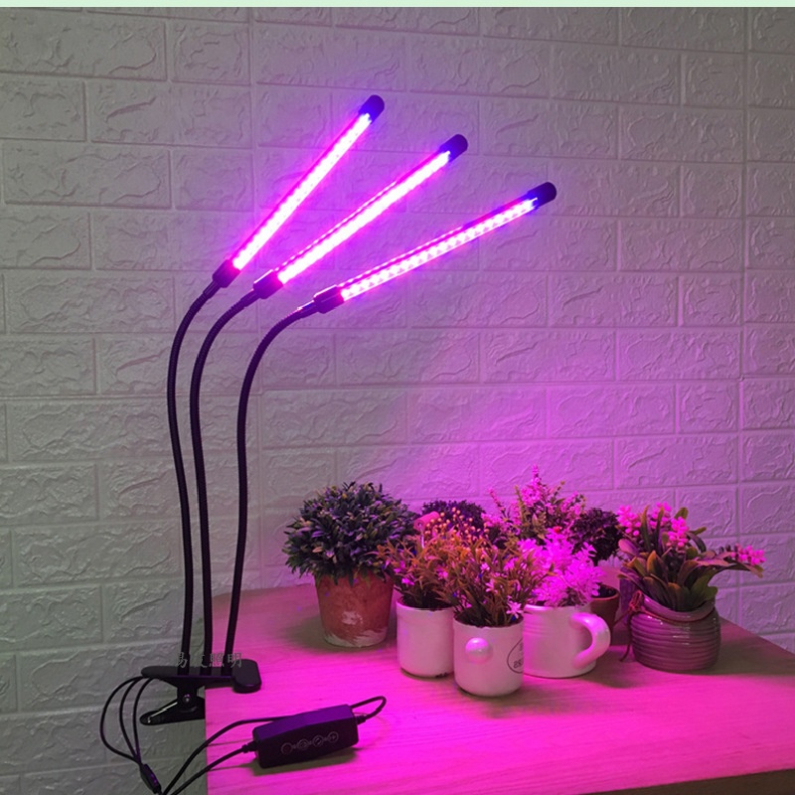
GL04
Led Grow Light
Input Voltage:100-277V AC, 50/60 Hz
Material:Plastic + Aluminum+Iron
LED driver brand：MEANWELL
Power factor：>90%
Led Chip:Epistar
Warranty:3 Years
Lifespan:50000Hours
Item Number | Wattage | Led Quantity | Luminous Flux | Beam Angle
GL04 | 20W | 2.8umol/j | 12 Bands | 110*80*620
 | 30W | 2.8umol/j |  | 110*80*620
 | 40W | 2.8umol/j |  | 110*80*620
Modern Ceiling Light Material:Iron base+ PMMA Cover Input Voltage:AC85-265V Led Chip:2835SMD IP Rating:IP44 CRI>80 PF>0.9 Color Temperature:3000K/4500K/6000K Operating Temperature:-25℃ ~50℃ Life Span:50000hours Certificate:CE ROHS
Item Number | Wattage | LedQuantity | LuminousFlux | Beam Angle | Size (mm) | WIFI Control Remte control Switch control Dimmer control
CL-N00 | 24W | 48pcs2835SMD | 1920-2160lm | 120° | 350mm | Yes
 | 36W | 72pcs2835SMD | 2880-3240lm | 120° | 400mm
 | 40W | 80pcs2835SMD | 3200-3600lm | 120° | 450mm
Modern Ceiling Light Material:Iron base+ PMMA Cover Input Voltage:AC85-265V Led Chip:2835SMD IP Rating:IP44 CRI>80 PF>0.9 Color Temperature:3000K/4500K/6000K Operating Temperature:-25℃ ~50℃ Life Span:50000hours Certificate:CE ROHS
Item Number | Wattage | LedQuantity | LuminousFlux | Beam Angle | Size (mm) | WIFI Control Remte control Switch control Dimmer control
CL-N00 | 24W | 48pcs2835SMD | 1920-2160lm | 120° | 350mm | Yes
 | 36W | 72pcs2835SMD | 2880-3240lm | 120° | 400mm
 | 40W | 80pcs2835SMD | 3200-3600lm | 120° | 450mm
Modern Ceiling Light Material:Iron base+ PMMA Cover Input Voltage:AC85-265V Led Chip:2835SMD IP Rating:IP44 CRI>80 PF>0.9 Color Temperature:3000K/4500K/6000K Operating Temperature:-25℃ ~50℃ Life Span:50000hours Certificate:CE ROHS
Item Number | Wattage | LedQuantity | LuminousFlux | Beam Angle | Size (mm) | WIFI Control Remte control Switch control Dimmer control
CL-N00 | 24W | 48pcs2835SMD | 1920-2160lm | 120° | 350mm | Yes
 | 36W | 72pcs2835SMD | 2880-3240lm | 120° | 400mm
 | 40W | 80pcs2835SMD | 3200-3600lm | 120° | 450mm
Modern Ceiling Light Material:Iron base+ PMMA Cover Input Voltage:AC85-265V Led Chip:2835SMD IP Rating:IP44 CRI>80 PF>0.9 Color Temperature:3000K/4500K/6000K Operating Temperature:-25℃ ~50℃ Life Span:50000hours Certificate:CE ROHS
Item Number | Wattage | LedQuantity | LuminousFlux | Beam Angle | Size (mm) | WIFI Control Remte control Switch control Dimmer control
CL-N00 | 24W | 48pcs2835SMD | 1920-2160lm | 120° | 350mm | Yes
 | 36W | 72pcs2835SMD | 2880-3240lm | 120° | 400mm
 | 40W | 80pcs2835SMD | 3200-3600lm | 120° | 450mm

Slide 5
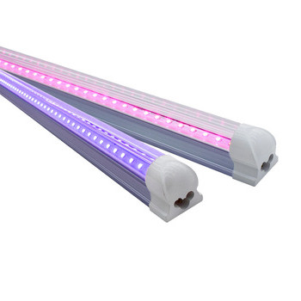
GL05
Frameless panel light
Material:Aluminum+PMMA/PS/MS Cover
Input Voltage:AC85- 265V
Led Chip:2835SMD
Chip Brand :Epistar
IP Rating:IP44 CRI>80 PF>0.9
Color Temperature:3000K/4500K/6000K
Operating Temperature:-20℃ -50℃
Life Span：50000hours
Certificate：CE,ROHS
Item Number | Wattage | Led Quantity | Luminous Flux | Beam Angle
GL05 | 9W | 2.8umol/j | Full spectrum | Can be customized
 | 18W | 2.8umol/j
 | 36W | 2.8umol/j
 | 60W | 2.8umol/j
Modern Ceiling Light Material:Iron base+ PMMA Cover Input Voltage:AC85-265V Led Chip:2835SMD IP Rating:IP44 CRI>80 PF>0.9 Color Temperature:3000K/4500K/6000K Operating Temperature:-25℃ ~50℃ Life Span:50000hours Certificate:CE ROHS
Item Number | Wattage | LedQuantity | LuminousFlux | Beam Angle | Size (mm) | WIFI Control Remte control Switch control Dimmer control
CL-N00 | 24W | 48pcs2835SMD | 1920-2160lm | 120° | 350mm | Yes
 | 36W | 72pcs2835SMD | 2880-3240lm | 120° | 400mm
 | 40W | 80pcs2835SMD | 3200-3600lm | 120° | 450mm
Modern Ceiling Light Material:Iron base+ PMMA Cover Input Voltage:AC85-265V Led Chip:2835SMD IP Rating:IP44 CRI>80 PF>0.9 Color Temperature:3000K/4500K/6000K Operating Temperature:-25℃ ~50℃ Life Span:50000hours Certificate:CE ROHS
Item Number | Wattage | LedQuantity | LuminousFlux | Beam Angle | Size (mm) | WIFI Control Remte control Switch control Dimmer control
CL-N00 | 24W | 48pcs2835SMD | 1920-2160lm | 120° | 350mm | Yes
 | 36W | 72pcs2835SMD | 2880-3240lm | 120° | 400mm
 | 40W | 80pcs2835SMD | 3200-3600lm | 120° | 450mm
Modern Ceiling Light Material:Iron base+ PMMA Cover Input Voltage:AC85-265V Led Chip:2835SMD IP Rating:IP44 CRI>80 PF>0.9 Color Temperature:3000K/4500K/6000K Operating Temperature:-25℃ ~50℃ Life Span:50000hours Certificate:CE ROHS
Item Number | Wattage | LedQuantity | LuminousFlux | Beam Angle | Size (mm) | WIFI Control Remte control Switch control Dimmer control
CL-N00 | 24W | 48pcs2835SMD | 1920-2160lm | 120° | 350mm | Yes
 | 36W | 72pcs2835SMD | 2880-3240lm | 120° | 400mm
 | 40W | 80pcs2835SMD | 3200-3600lm | 120° | 450mm
Modern Ceiling Light Material:Iron base+ PMMA Cover Input Voltage:AC85-265V Led Chip:2835SMD IP Rating:IP44 CRI>80 PF>0.9 Color Temperature:3000K/4500K/6000K Operating Temperature:-25℃ ~50℃ Life Span:50000hours Certificate:CE ROHS
Item Number | Wattage | LedQuantity | LuminousFlux | Beam Angle | Size (mm) | WIFI Control Remte control Switch control Dimmer control
CL-N00 | 24W | 48pcs2835SMD | 1920-2160lm | 120° | 350mm | Yes
 | 36W | 72pcs2835SMD | 2880-3240lm | 120° | 400mm
 | 40W | 80pcs2835SMD | 3200-3600lm | 120° | 450mm

Slide 6
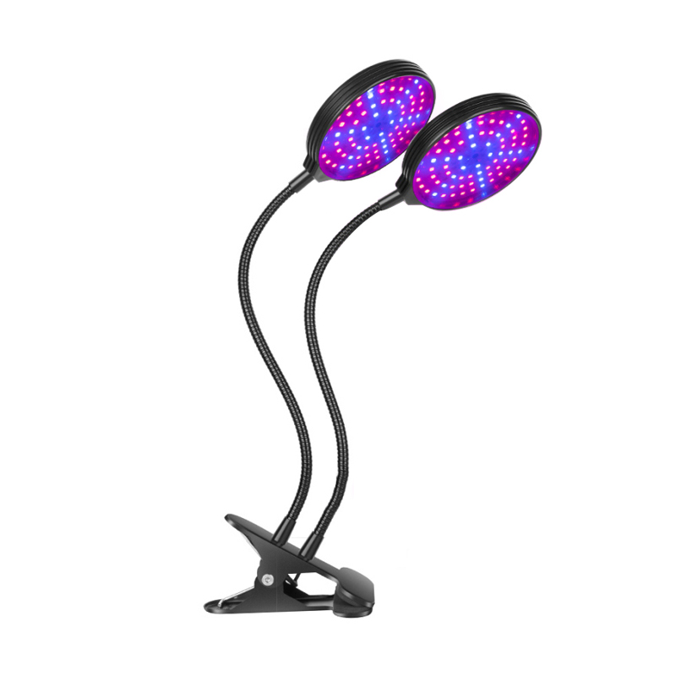
CL06
Frameless panel light
Material:Aluminum+PMMA/PS/MS Cover
Input Voltage:AC85- 265V
Led Chip:2835SMD
Chip Brand :Epistar
IP Rating:IP44 CRI>80 PF>0.9
Color Temperature:3000K/4500K/6000K
Operating Temperature:-20℃ -50℃
Life Span：50000hours
Certificate：CE,ROHS
Item Number | Wattage | Led Quantity | Luminous Flux | Beam Angle
CL06 | 15W | 2.8umol/j | Full spectrum | 550*280*120
 | 30W | 2.8umol/j |  | 550*280*120
 | 45W | 2.8umol/j |  | 550*280*120
 | 60W | 2.8umol/j |  | 550*280*120
Modern Ceiling Light Material:Iron base+ PMMA Cover Input Voltage:AC85-265V Led Chip:2835SMD IP Rating:IP44 CRI>80 PF>0.9 Color Temperature:3000K/4500K/6000K Operating Temperature:-25℃ ~50℃ Life Span:50000hours Certificate:CE ROHS
Item Number | Wattage | LedQuantity | LuminousFlux | Beam Angle | Size (mm) | WIFI Control Remte control Switch control Dimmer control
CL-N00 | 24W | 48pcs2835SMD | 1920-2160lm | 120° | 350mm | Yes
 | 36W | 72pcs2835SMD | 2880-3240lm | 120° | 400mm
 | 40W | 80pcs2835SMD | 3200-3600lm | 120° | 450mm
Modern Ceiling Light Material:Iron base+ PMMA Cover Input Voltage:AC85-265V Led Chip:2835SMD IP Rating:IP44 CRI>80 PF>0.9 Color Temperature:3000K/4500K/6000K Operating Temperature:-25℃ ~50℃ Life Span:50000hours Certificate:CE ROHS
Item Number | Wattage | LedQuantity | LuminousFlux | Beam Angle | Size (mm) | WIFI Control Remte control Switch control Dimmer control
CL-N00 | 24W | 48pcs2835SMD | 1920-2160lm | 120° | 350mm | Yes
 | 36W | 72pcs2835SMD | 2880-3240lm | 120° | 400mm
 | 40W | 80pcs2835SMD | 3200-3600lm | 120° | 450mm
Modern Ceiling Light Material:Iron base+ PMMA Cover Input Voltage:AC85-265V Led Chip:2835SMD IP Rating:IP44 CRI>80 PF>0.9 Color Temperature:3000K/4500K/6000K Operating Temperature:-25℃ ~50℃ Life Span:50000hours Certificate:CE ROHS
Item Number | Wattage | LedQuantity | LuminousFlux | Beam Angle | Size (mm) | WIFI Control Remte control Switch control Dimmer control
CL-N00 | 24W | 48pcs2835SMD | 1920-2160lm | 120° | 350mm | Yes
 | 36W | 72pcs2835SMD | 2880-3240lm | 120° | 400mm
 | 40W | 80pcs2835SMD | 3200-3600lm | 120° | 450mm
Modern Ceiling Light Material:Iron base+ PMMA Cover Input Voltage:AC85-265V Led Chip:2835SMD IP Rating:IP44 CRI>80 PF>0.9 Color Temperature:3000K/4500K/6000K Operating Temperature:-25℃ ~50℃ Life Span:50000hours Certificate:CE ROHS
Item Number | Wattage | LedQuantity | LuminousFlux | Beam Angle | Size (mm) | WIFI Control Remte control Switch control Dimmer control
CL-N00 | 24W | 48pcs2835SMD | 1920-2160lm | 120° | 350mm | Yes
 | 36W | 72pcs2835SMD | 2880-3240lm | 120° | 400mm
 | 40W | 80pcs2835SMD | 3200-3600lm | 120° | 450mm

