Slide 1
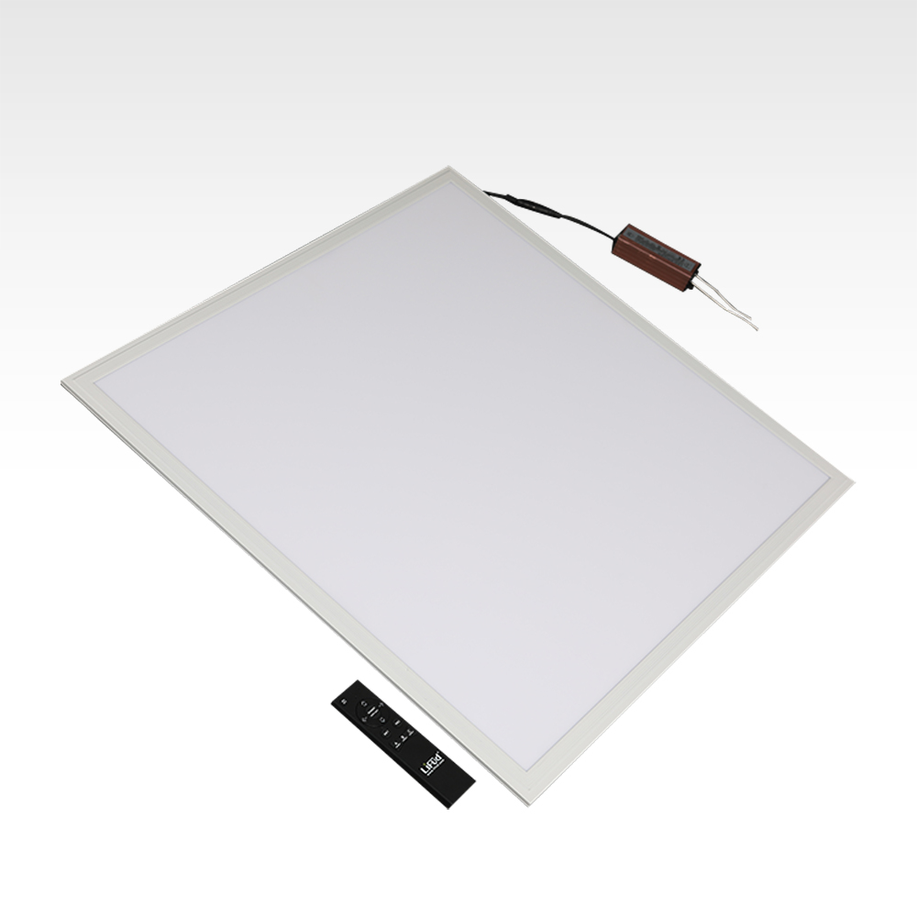
PBL01
Material:Aluminum+PMMA/PS/MS Cover
Input Voltage:AC85- 265V
Led Chip:2835SMD
Chip Brand :Epistar
IP Rating:IP44 CRI>80 PF>0.9
Color Temperature:3000K/4500K/6000K
Operating Temperature:-20℃ -50℃
Life Span：50000hours
Certificate：CE,ROHS
Item Number | Wattage | Led Quantity | Luminous Flux | Beam Angle | Size (mm) | WIFI Control Remte Control Switch Control Dimmer Control
PBL01 | 18W | 36pcs 2835SMD | 1440-1620lm | 120° | 300*300mm | YES
 | 24W | 48pcs 2835SMD | 1920-2160lm | 120° | 600*600mm
 | 48W | 96pcs2835SMD | 3840-4320lm | 120° | 600*600mm
 | 60W | 120pcs2835SMD | 4800-5400lm | 120° | 600*600mm
 | 72W | 144pcs2835SMD | 5760-6480lm | 120° | 600*600mm
Modern Ceiling Light Material:Iron base+ PMMA Cover Input Voltage:AC85-265V Led Chip:2835SMD IP Rating:IP44 CRI>80 PF>0.9 Color Temperature:3000K/4500K/6000K Operating Temperature:-25℃ ~50℃ Life Span:50000hours Certificate:CE ROHS
Item Number | Wattage | LedQuantity | LuminousFlux | Beam Angle | Size (mm) | WIFI Control Remte control Switch control Dimmer control
CL-N00 | 24W | 48pcs2835SMD | 1920-2160lm | 120° | 350mm | Yes
 | 36W | 72pcs2835SMD | 2880-3240lm | 120° | 400mm
 | 40W | 80pcs2835SMD | 3200-3600lm | 120° | 450mm
Modern Ceiling Light Material:Iron base+ PMMA Cover Input Voltage:AC85-265V Led Chip:2835SMD IP Rating:IP44 CRI>80 PF>0.9 Color Temperature:3000K/4500K/6000K Operating Temperature:-25℃ ~50℃ Life Span:50000hours Certificate:CE ROHS
Item Number | Wattage | LedQuantity | LuminousFlux | Beam Angle | Size (mm) | WIFI Control Remte control Switch control Dimmer control
CL-N00 | 24W | 48pcs2835SMD | 1920-2160lm | 120° | 350mm | Yes
 | 36W | 72pcs2835SMD | 2880-3240lm | 120° | 400mm
 | 40W | 80pcs2835SMD | 3200-3600lm | 120° | 450mm
Modern Ceiling Light Material:Iron base+ PMMA Cover Input Voltage:AC85-265V Led Chip:2835SMD IP Rating:IP44 CRI>80 PF>0.9 Color Temperature:3000K/4500K/6000K Operating Temperature:-25℃ ~50℃ Life Span:50000hours Certificate:CE ROHS
Item Number | Wattage | LedQuantity | LuminousFlux | Beam Angle | Size (mm) | WIFI Control Remte control Switch control Dimmer control
CL-N00 | 24W | 48pcs2835SMD | 1920-2160lm | 120° | 350mm | Yes
 | 36W | 72pcs2835SMD | 2880-3240lm | 120° | 400mm
 | 40W | 80pcs2835SMD | 3200-3600lm | 120° | 450mm
Modern Ceiling Light Material:Iron base+ PMMA Cover Input Voltage:AC85-265V Led Chip:2835SMD IP Rating:IP44 CRI>80 PF>0.9 Color Temperature:3000K/4500K/6000K Operating Temperature:-25℃ ~50℃ Life Span:50000hours Certificate:CE ROHS
Item Number | Wattage | LedQuantity | LuminousFlux | Beam Angle | Size (mm) | WIFI Control Remte control Switch control Dimmer control
CL-N00 | 24W | 48pcs2835SMD | 1920-2160lm | 120° | 350mm | Yes
 | 36W | 72pcs2835SMD | 2880-3240lm | 120° | 400mm
 | 40W | 80pcs2835SMD | 3200-3600lm | 120° | 450mm

Slide 2
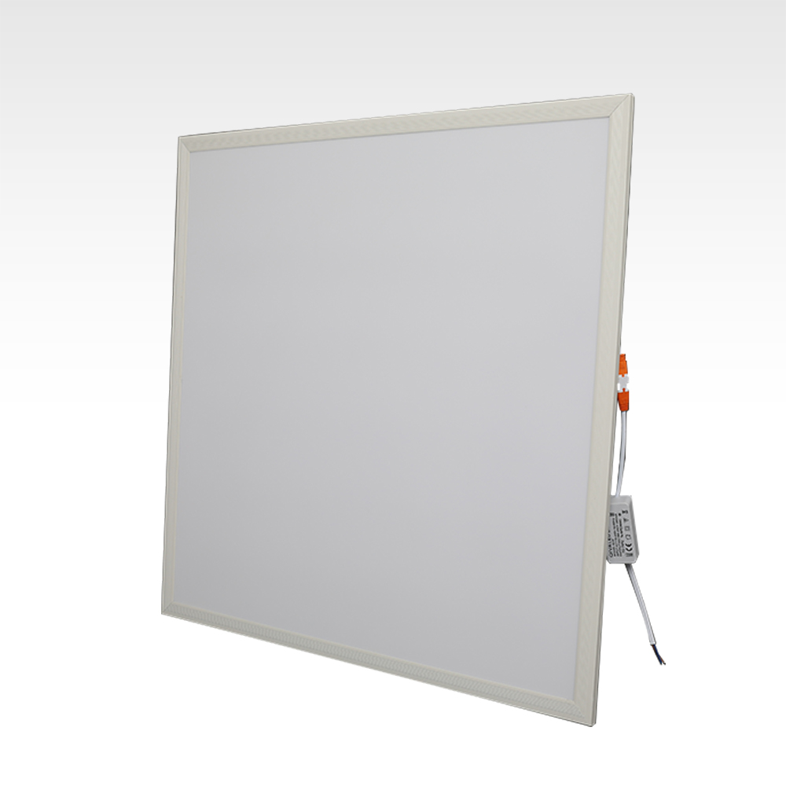
PSL01
Material:Aluminum+PMMA/PS/MS Cover
Input Voltage:AC85- 265V
Led Chip:2835SMD
Chip Brand :Epistar
IP Rating:IP44 CRI>80 PF>0.9
Color Temperature:3000K/4500K/6000K
Operating Temperature:-20℃ -50℃
Life Span：50000hours
Certificate：CE,ROHS
Item Number | Wattage | Led Quantity | Luminous Flux | Beam Angle | Size (mm) | WIFI Control Remte Control Switch Control Dimmer Control
PSL01 | 18W | 36pcs 2835SMD | 1440-1620lm | 120° | 300*300mm | YES
 | 24W | 48pcs 2835SMD | 1920-2160lm | 120° | 600*600mm
 | 48W | 96pcs2835SMD | 3840-4320lm | 120° | 600*600mm
 | 60W | 120pcs2835SMD | 4800-5400lm | 120° | 600*600mm
 | 72W | 144pcs2835SMD | 5760-6480lm | 120° | 600*600mm
Modern Ceiling Light Material:Iron base+ PMMA Cover Input Voltage:AC85-265V Led Chip:2835SMD IP Rating:IP44 CRI>80 PF>0.9 Color Temperature:3000K/4500K/6000K Operating Temperature:-25℃ ~50℃ Life Span:50000hours Certificate:CE ROHS
Item Number | Wattage | LedQuantity | LuminousFlux | Beam Angle | Size (mm) | WIFI Control Remte control Switch control Dimmer control
CL-N00 | 24W | 48pcs2835SMD | 1920-2160lm | 120° | 350mm | Yes
 | 36W | 72pcs2835SMD | 2880-3240lm | 120° | 400mm
 | 40W | 80pcs2835SMD | 3200-3600lm | 120° | 450mm
Modern Ceiling Light Material:Iron base+ PMMA Cover Input Voltage:AC85-265V Led Chip:2835SMD IP Rating:IP44 CRI>80 PF>0.9 Color Temperature:3000K/4500K/6000K Operating Temperature:-25℃ ~50℃ Life Span:50000hours Certificate:CE ROHS
Item Number | Wattage | LedQuantity | LuminousFlux | Beam Angle | Size (mm) | WIFI Control Remte control Switch control Dimmer control
CL-N00 | 24W | 48pcs2835SMD | 1920-2160lm | 120° | 350mm | Yes
 | 36W | 72pcs2835SMD | 2880-3240lm | 120° | 400mm
 | 40W | 80pcs2835SMD | 3200-3600lm | 120° | 450mm
Modern Ceiling Light Material:Iron base+ PMMA Cover Input Voltage:AC85-265V Led Chip:2835SMD IP Rating:IP44 CRI>80 PF>0.9 Color Temperature:3000K/4500K/6000K Operating Temperature:-25℃ ~50℃ Life Span:50000hours Certificate:CE ROHS
Item Number | Wattage | LedQuantity | LuminousFlux | Beam Angle | Size (mm) | WIFI Control Remte control Switch control Dimmer control
CL-N00 | 24W | 48pcs2835SMD | 1920-2160lm | 120° | 350mm | Yes
 | 36W | 72pcs2835SMD | 2880-3240lm | 120° | 400mm
 | 40W | 80pcs2835SMD | 3200-3600lm | 120° | 450mm
Modern Ceiling Light Material:Iron base+ PMMA Cover Input Voltage:AC85-265V Led Chip:2835SMD IP Rating:IP44 CRI>80 PF>0.9 Color Temperature:3000K/4500K/6000K Operating Temperature:-25℃ ~50℃ Life Span:50000hours Certificate:CE ROHS
Item Number | Wattage | LedQuantity | LuminousFlux | Beam Angle | Size (mm) | WIFI Control Remte control Switch control Dimmer control
CL-N00 | 24W | 48pcs2835SMD | 1920-2160lm | 120° | 350mm | Yes
 | 36W | 72pcs2835SMD | 2880-3240lm | 120° | 400mm
 | 40W | 80pcs2835SMD | 3200-3600lm | 120° | 450mm

Slide 3
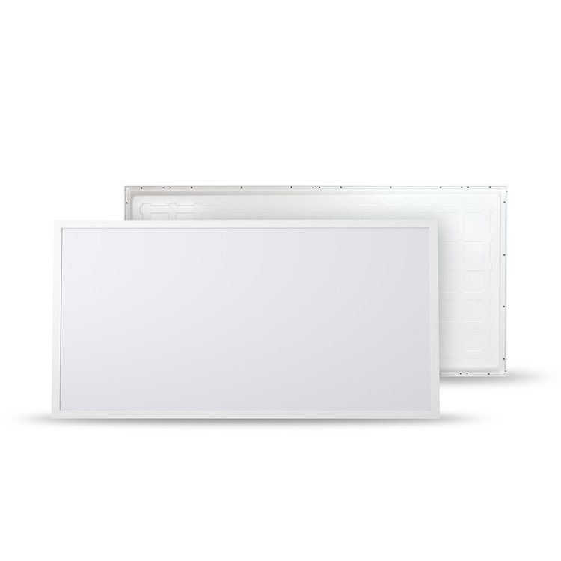
PBL02
Material:Aluminum+PMMA/PS/MS Cover
Input Voltage:AC85- 265V
Led Chip:2835SMD
Chip Brand :Epistar
IP Rating:IP44 CRI>80 PF>0.9
Color Temperature:3000K/4500K/6000K
Operating Temperature:-20℃ -50℃
Life Span：50000hours
Certificate：CE,ROHS
Item Number | Wattage | Led Quantity | Luminous Flux | Beam Angle | Size (mm) | WIFI Control Remte Control Switch Control Dimmer Control
PBL02 | 48W | 96pcs2835SMD | 3840-4320lm | 120° | 300*1200mm | YES
 | 60W | 120pcs2835SMD | 4800-5400lm | 120° | 600*1200mm
 | 72W | 144pcs2835SMD | 5760-6480lm | 120° | 600*1200mm
 | 96W | 192pcs2835SMD | 7680-8640lm | 120° | 600*1200mm
 | 120W | 240pcs2835SMD | 9600-10800lm | 120° | 600*1200mm
Modern Ceiling Light Material:Iron base+ PMMA Cover Input Voltage:AC85-265V Led Chip:2835SMD IP Rating:IP44 CRI>80 PF>0.9 Color Temperature:3000K/4500K/6000K Operating Temperature:-25℃ ~50℃ Life Span:50000hours Certificate:CE ROHS
Item Number | Wattage | LedQuantity | LuminousFlux | Beam Angle | Size (mm) | WIFI Control Remte control Switch control Dimmer control
CL-N00 | 24W | 48pcs2835SMD | 1920-2160lm | 120° | 350mm | Yes
 | 36W | 72pcs2835SMD | 2880-3240lm | 120° | 400mm
 | 40W | 80pcs2835SMD | 3200-3600lm | 120° | 450mm
Modern Ceiling Light Material:Iron base+ PMMA Cover Input Voltage:AC85-265V Led Chip:2835SMD IP Rating:IP44 CRI>80 PF>0.9 Color Temperature:3000K/4500K/6000K Operating Temperature:-25℃ ~50℃ Life Span:50000hours Certificate:CE ROHS
Item Number | Wattage | LedQuantity | LuminousFlux | Beam Angle | Size (mm) | WIFI Control Remte control Switch control Dimmer control
CL-N00 | 24W | 48pcs2835SMD | 1920-2160lm | 120° | 350mm | Yes
 | 36W | 72pcs2835SMD | 2880-3240lm | 120° | 400mm
 | 40W | 80pcs2835SMD | 3200-3600lm | 120° | 450mm
Modern Ceiling Light Material:Iron base+ PMMA Cover Input Voltage:AC85-265V Led Chip:2835SMD IP Rating:IP44 CRI>80 PF>0.9 Color Temperature:3000K/4500K/6000K Operating Temperature:-25℃ ~50℃ Life Span:50000hours Certificate:CE ROHS
Item Number | Wattage | LedQuantity | LuminousFlux | Beam Angle | Size (mm) | WIFI Control Remte control Switch control Dimmer control
CL-N00 | 24W | 48pcs2835SMD | 1920-2160lm | 120° | 350mm | Yes
 | 36W | 72pcs2835SMD | 2880-3240lm | 120° | 400mm
 | 40W | 80pcs2835SMD | 3200-3600lm | 120° | 450mm
Modern Ceiling Light Material:Iron base+ PMMA Cover Input Voltage:AC85-265V Led Chip:2835SMD IP Rating:IP44 CRI>80 PF>0.9 Color Temperature:3000K/4500K/6000K Operating Temperature:-25℃ ~50℃ Life Span:50000hours Certificate:CE ROHS
Item Number | Wattage | LedQuantity | LuminousFlux | Beam Angle | Size (mm) | WIFI Control Remte control Switch control Dimmer control
CL-N00 | 24W | 48pcs2835SMD | 1920-2160lm | 120° | 350mm | Yes
 | 36W | 72pcs2835SMD | 2880-3240lm | 120° | 400mm
 | 40W | 80pcs2835SMD | 3200-3600lm | 120° | 450mm

Slide 4
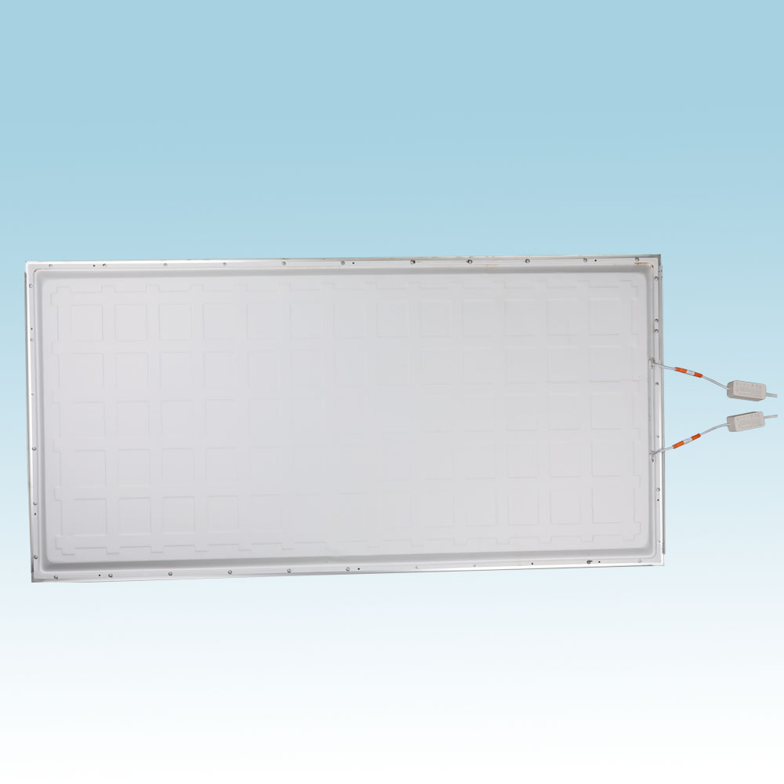
PSL02
Material:Aluminum+PMMA/PS/MS Cover
Input Voltage:AC85- 265V
Led Chip:2835SMD
Chip Brand :Epistar
IP Rating:IP44 CRI>80 PF>0.9
Color Temperature:3000K/4500K/6000K
Operating Temperature:-20℃ -50℃
Life Span：50000hours
Certificate：CE,ROHS
Item Number | Wattage | Led Quantity | Luminous Flux | Beam Angle | Size (mm) | WIFI Control Remte Control Switch Control Dimmer Control
PSL02 | 48W | 96pcs2835SMD | 3840-4320lm | 120° | 300*1200mm | YES
 | 60W | 120pcs2835SMD | 4800-5400lm | 120° | 600*1200mm
 | 72W | 144pcs2835SMD | 5760-6480lm | 120° | 600*1200mm
 | 96W | 192pcs2835SMD | 7680-8640lm | 120° | 600*1200mm
 | 120W | 240pcs2835SMD | 9600-10800lm | 120° | 600*1200mm
Modern Ceiling Light Material:Iron base+ PMMA Cover Input Voltage:AC85-265V Led Chip:2835SMD IP Rating:IP44 CRI>80 PF>0.9 Color Temperature:3000K/4500K/6000K Operating Temperature:-25℃ ~50℃ Life Span:50000hours Certificate:CE ROHS
Item Number | Wattage | LedQuantity | LuminousFlux | Beam Angle | Size (mm) | WIFI Control Remte control Switch control Dimmer control
CL-N00 | 24W | 48pcs2835SMD | 1920-2160lm | 120° | 350mm | Yes
 | 36W | 72pcs2835SMD | 2880-3240lm | 120° | 400mm
 | 40W | 80pcs2835SMD | 3200-3600lm | 120° | 450mm
Modern Ceiling Light Material:Iron base+ PMMA Cover Input Voltage:AC85-265V Led Chip:2835SMD IP Rating:IP44 CRI>80 PF>0.9 Color Temperature:3000K/4500K/6000K Operating Temperature:-25℃ ~50℃ Life Span:50000hours Certificate:CE ROHS
Item Number | Wattage | LedQuantity | LuminousFlux | Beam Angle | Size (mm) | WIFI Control Remte control Switch control Dimmer control
CL-N00 | 24W | 48pcs2835SMD | 1920-2160lm | 120° | 350mm | Yes
 | 36W | 72pcs2835SMD | 2880-3240lm | 120° | 400mm
 | 40W | 80pcs2835SMD | 3200-3600lm | 120° | 450mm
Modern Ceiling Light Material:Iron base+ PMMA Cover Input Voltage:AC85-265V Led Chip:2835SMD IP Rating:IP44 CRI>80 PF>0.9 Color Temperature:3000K/4500K/6000K Operating Temperature:-25℃ ~50℃ Life Span:50000hours Certificate:CE ROHS
Item Number | Wattage | LedQuantity | LuminousFlux | Beam Angle | Size (mm) | WIFI Control Remte control Switch control Dimmer control
CL-N00 | 24W | 48pcs2835SMD | 1920-2160lm | 120° | 350mm | Yes
 | 36W | 72pcs2835SMD | 2880-3240lm | 120° | 400mm
 | 40W | 80pcs2835SMD | 3200-3600lm | 120° | 450mm
Modern Ceiling Light Material:Iron base+ PMMA Cover Input Voltage:AC85-265V Led Chip:2835SMD IP Rating:IP44 CRI>80 PF>0.9 Color Temperature:3000K/4500K/6000K Operating Temperature:-25℃ ~50℃ Life Span:50000hours Certificate:CE ROHS
Item Number | Wattage | LedQuantity | LuminousFlux | Beam Angle | Size (mm) | WIFI Control Remte control Switch control Dimmer control
CL-N00 | 24W | 48pcs2835SMD | 1920-2160lm | 120° | 350mm | Yes
 | 36W | 72pcs2835SMD | 2880-3240lm | 120° | 400mm
 | 40W | 80pcs2835SMD | 3200-3600lm | 120° | 450mm

Slide 5
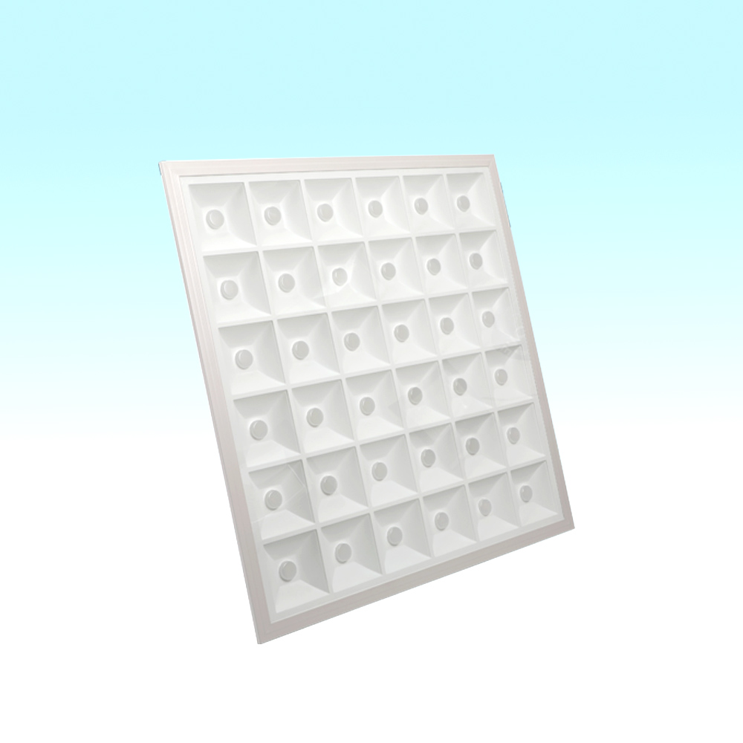
PL03
Frameless panel light
Material:Aluminum+PMMA/PS/MS Cover
Input Voltage:AC85- 265V
Led Chip:2835SMD
Chip Brand :Epistar
IP Rating:IP44 CRI>80 PF>0.9
Color Temperature:3000K/4500K/6000K
Operating Temperature:-20℃ -50℃
Life Span：50000hours
Certificate：CE,ROHS
Item Number | Wattage | Led Quantity | Luminous Flux | Beam Angle | Size (mm) | WIFI Control Remte Control Switch Control Dimmer Control
PL03 | 9W | 18pcs 2835SMD | 720-810lm | 120° | φ93 | 50-80
 | 18W | 36pcs 2835SMD | 1440-1620lm | 120° | φ123 | 50-110
Modern Ceiling Light Material:Iron base+ PMMA Cover Input Voltage:AC85-265V Led Chip:2835SMD IP Rating:IP44 CRI>80 PF>0.9 Color Temperature:3000K/4500K/6000K Operating Temperature:-25℃ ~50℃ Life Span:50000hours Certificate:CE ROHS
Item Number | Wattage | LedQuantity | LuminousFlux | Beam Angle | Size (mm) | WIFI Control Remte control Switch control Dimmer control
CL-N00 | 24W | 48pcs2835SMD | 1920-2160lm | 120° | 350mm | Yes
 | 36W | 72pcs2835SMD | 2880-3240lm | 120° | 400mm
 | 40W | 80pcs2835SMD | 3200-3600lm | 120° | 450mm
Modern Ceiling Light Material:Iron base+ PMMA Cover Input Voltage:AC85-265V Led Chip:2835SMD IP Rating:IP44 CRI>80 PF>0.9 Color Temperature:3000K/4500K/6000K Operating Temperature:-25℃ ~50℃ Life Span:50000hours Certificate:CE ROHS
Item Number | Wattage | LedQuantity | LuminousFlux | Beam Angle | Size (mm) | WIFI Control Remte control Switch control Dimmer control
CL-N00 | 24W | 48pcs2835SMD | 1920-2160lm | 120° | 350mm | Yes
 | 36W | 72pcs2835SMD | 2880-3240lm | 120° | 400mm
 | 40W | 80pcs2835SMD | 3200-3600lm | 120° | 450mm
Modern Ceiling Light Material:Iron base+ PMMA Cover Input Voltage:AC85-265V Led Chip:2835SMD IP Rating:IP44 CRI>80 PF>0.9 Color Temperature:3000K/4500K/6000K Operating Temperature:-25℃ ~50℃ Life Span:50000hours Certificate:CE ROHS
Item Number | Wattage | LedQuantity | LuminousFlux | Beam Angle | Size (mm) | WIFI Control Remte control Switch control Dimmer control
CL-N00 | 24W | 48pcs2835SMD | 1920-2160lm | 120° | 350mm | Yes
 | 36W | 72pcs2835SMD | 2880-3240lm | 120° | 400mm
 | 40W | 80pcs2835SMD | 3200-3600lm | 120° | 450mm
Modern Ceiling Light Material:Iron base+ PMMA Cover Input Voltage:AC85-265V Led Chip:2835SMD IP Rating:IP44 CRI>80 PF>0.9 Color Temperature:3000K/4500K/6000K Operating Temperature:-25℃ ~50℃ Life Span:50000hours Certificate:CE ROHS
Item Number | Wattage | LedQuantity | LuminousFlux | Beam Angle | Size (mm) | WIFI Control Remte control Switch control Dimmer control
CL-N00 | 24W | 48pcs2835SMD | 1920-2160lm | 120° | 350mm | Yes
 | 36W | 72pcs2835SMD | 2880-3240lm | 120° | 400mm
 | 40W | 80pcs2835SMD | 3200-3600lm | 120° | 450mm

Slide 6
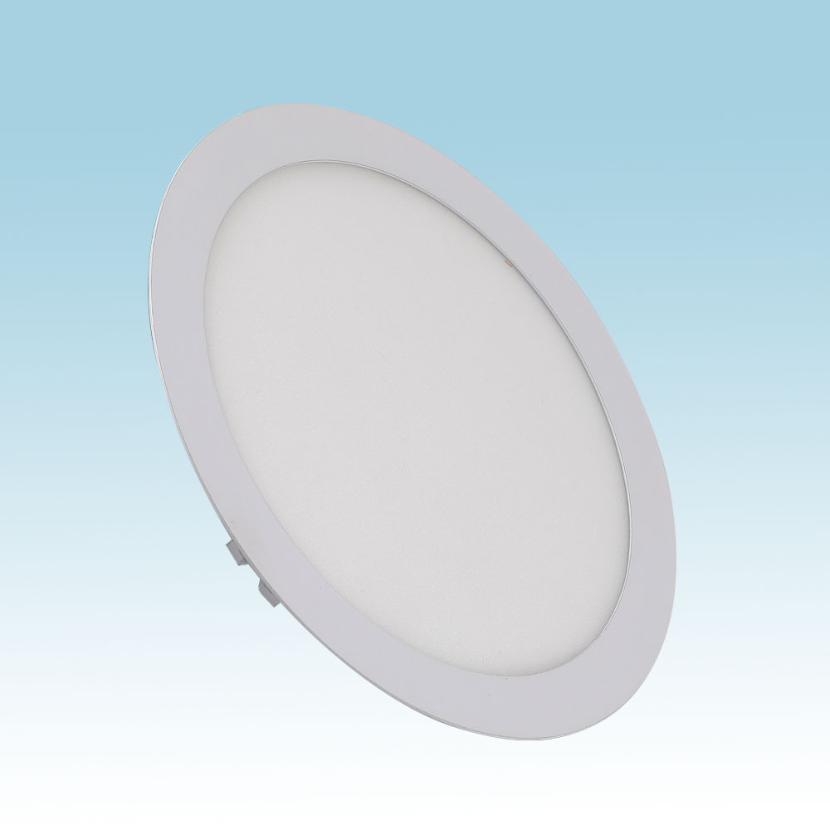
PL05-R
Material:Iron base+ PMMA Cover
Input Voltage:AC85-265V
Led Chip:2835SMD
IP Rating:IP44 CRI>80 PF>0.9
Color Temperature:3000K/4500K/6000K
Operating Temperature:-25℃ ~50℃
Life Span:50000hours
Certificate:CE ROHS
Item Number | Wattage | LedQuantity | LuminousFlux | Beam Angle | Size (mm) | Open size（mm)
PL05-R | 3W | 6pcs2835SMD | 240-270lm | 120° | Φ85 | Φ68
 | 6W | 12pcs2835SMD | 480-540lm | 120° | Φ120 | Φ105
 | 9W | 18pcs2835SMD | 630-810lm | 120° | Φ145 | Φ125
 | 12W | 24pcs2835SMD | 960-1080lm | 120° | Φ170 | Φ150
 | 15W | 30pcs2835SMD | 1200-1350lm | 120° | Φ190 | Φ170
 | 18W | 36pcs2835SMD | 1440-1620lm | 120° | Φ220 | Φ200
 | 24W | 48pcs2835SMD | 1920-2160lm | 120° | Φ300 | Φ280
 | 30W | 60pcs2835SMD | 2400-2700lm | 120° | Φ300 | Φ280
Modern Ceiling Light Material:Iron base+ PMMA Cover Input Voltage:AC85-265V Led Chip:2835SMD IP Rating:IP44 CRI>80 PF>0.9 Color Temperature:3000K/4500K/6000K Operating Temperature:-25℃ ~50℃ Life Span:50000hours Certificate:CE ROHS
Item Number | Wattage | LedQuantity | LuminousFlux | Beam Angle | Size (mm) | WIFI Control Remte control Switch control Dimmer control
CL-N00 | 24W | 48pcs2835SMD | 1920-2160lm | 120° | 350mm | Yes
 | 36W | 72pcs2835SMD | 2880-3240lm | 120° | 400mm
 | 40W | 80pcs2835SMD | 3200-3600lm | 120° | 450mm
Modern Ceiling Light Material:Iron base+ PMMA Cover Input Voltage:AC85-265V Led Chip:2835SMD IP Rating:IP44 CRI>80 PF>0.9 Color Temperature:3000K/4500K/6000K Operating Temperature:-25℃ ~50℃ Life Span:50000hours Certificate:CE ROHS
Item Number | Wattage | LedQuantity | LuminousFlux | Beam Angle | Size (mm) | WIFI Control Remte control Switch control Dimmer control
CL-N00 | 24W | 48pcs2835SMD | 1920-2160lm | 120° | 350mm | Yes
 | 36W | 72pcs2835SMD | 2880-3240lm | 120° | 400mm
 | 40W | 80pcs2835SMD | 3200-3600lm | 120° | 450mm
Modern Ceiling Light Material:Iron base+ PMMA Cover Input Voltage:AC85-265V Led Chip:2835SMD IP Rating:IP44 CRI>80 PF>0.9 Color Temperature:3000K/4500K/6000K Operating Temperature:-25℃ ~50℃ Life Span:50000hours Certificate:CE ROHS
Item Number | Wattage | LedQuantity | LuminousFlux | Beam Angle | Size (mm) | WIFI Control Remte control Switch control Dimmer control
CL-N00 | 24W | 48pcs2835SMD | 1920-2160lm | 120° | 350mm | Yes
 | 36W | 72pcs2835SMD | 2880-3240lm | 120° | 400mm
 | 40W | 80pcs2835SMD | 3200-3600lm | 120° | 450mm
Modern Ceiling Light Material:Iron base+ PMMA Cover Input Voltage:AC85-265V Led Chip:2835SMD IP Rating:IP44 CRI>80 PF>0.9 Color Temperature:3000K/4500K/6000K Operating Temperature:-25℃ ~50℃ Life Span:50000hours Certificate:CE ROHS
Item Number | Wattage | LedQuantity | LuminousFlux | Beam Angle | Size (mm) | WIFI Control Remte control Switch control Dimmer control
CL-N00 | 24W | 48pcs2835SMD | 1920-2160lm | 120° | 350mm | Yes
 | 36W | 72pcs2835SMD | 2880-3240lm | 120° | 400mm
 | 40W | 80pcs2835SMD | 3200-3600lm | 120° | 450mm

Slide 7
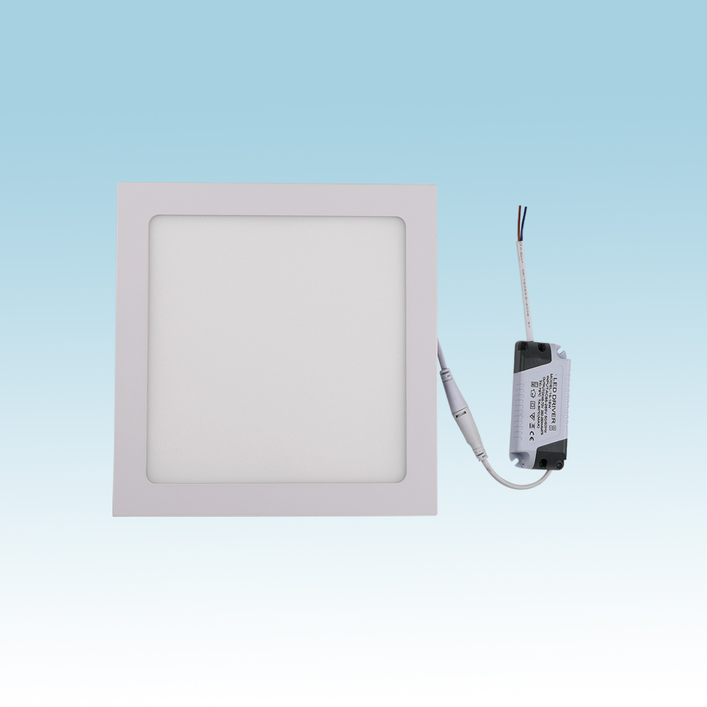
PL05-S
Material:Iron base+ PMMA Cover
Input Voltage:AC85-265V
Led Chip:2835SMD
IP Rating:IP44 CRI>80 PF>0.9
Color Temperature:3000K/4500K/6000K
Operating Temperature:-25℃ ~50℃
Life Span:50000hours
Certificate:CE ROHS
Item Number | Wattage | LedQuantity | LuminousFlux | Beam Angle | Size (mm) | Open size（mm)
PL05-S | 3W | 6pcs2835SMD | 240-270lm | 120° | Φ85 | Φ68
 | 6W | 12pcs2835SMD | 480-540lm | 120° | Φ120 | Φ105
 | 9W | 18pcs2835SMD | 630-810lm | 120° | Φ145 | Φ125
 | 12W | 24pcs2835SMD | 960-1080lm | 120° | Φ170 | Φ150
 | 15W | 30pcs2835SMD | 1200-1350lm | 120° | Φ190 | Φ170
 | 18W | 36pcs2835SMD | 1440-1620lm | 120° | Φ220 | Φ200
 | 24W | 48pcs2835SMD | 1920-2160lm | 120° | Φ300 | Φ280
 | 30W | 60pcs2835SMD | 2400-2700lm | 120° | Φ300 | Φ280
Modern Ceiling Light Material:Iron base+ PMMA Cover Input Voltage:AC85-265V Led Chip:2835SMD IP Rating:IP44 CRI>80 PF>0.9 Color Temperature:3000K/4500K/6000K Operating Temperature:-25℃ ~50℃ Life Span:50000hours Certificate:CE ROHS
Item Number | Wattage | LedQuantity | LuminousFlux | Beam Angle | Size (mm) | WIFI Control Remte control Switch control Dimmer control
CL-N00 | 24W | 48pcs2835SMD | 1920-2160lm | 120° | 350mm | Yes
 | 36W | 72pcs2835SMD | 2880-3240lm | 120° | 400mm
 | 40W | 80pcs2835SMD | 3200-3600lm | 120° | 450mm
Modern Ceiling Light Material:Iron base+ PMMA Cover Input Voltage:AC85-265V Led Chip:2835SMD IP Rating:IP44 CRI>80 PF>0.9 Color Temperature:3000K/4500K/6000K Operating Temperature:-25℃ ~50℃ Life Span:50000hours Certificate:CE ROHS
Item Number | Wattage | LedQuantity | LuminousFlux | Beam Angle | Size (mm) | WIFI Control Remte control Switch control Dimmer control
CL-N00 | 24W | 48pcs2835SMD | 1920-2160lm | 120° | 350mm | Yes
 | 36W | 72pcs2835SMD | 2880-3240lm | 120° | 400mm
 | 40W | 80pcs2835SMD | 3200-3600lm | 120° | 450mm
Modern Ceiling Light Material:Iron base+ PMMA Cover Input Voltage:AC85-265V Led Chip:2835SMD IP Rating:IP44 CRI>80 PF>0.9 Color Temperature:3000K/4500K/6000K Operating Temperature:-25℃ ~50℃ Life Span:50000hours Certificate:CE ROHS
Item Number | Wattage | LedQuantity | LuminousFlux | Beam Angle | Size (mm) | WIFI Control Remte control Switch control Dimmer control
CL-N00 | 24W | 48pcs2835SMD | 1920-2160lm | 120° | 350mm | Yes
 | 36W | 72pcs2835SMD | 2880-3240lm | 120° | 400mm
 | 40W | 80pcs2835SMD | 3200-3600lm | 120° | 450mm
Modern Ceiling Light Material:Iron base+ PMMA Cover Input Voltage:AC85-265V Led Chip:2835SMD IP Rating:IP44 CRI>80 PF>0.9 Color Temperature:3000K/4500K/6000K Operating Temperature:-25℃ ~50℃ Life Span:50000hours Certificate:CE ROHS
Item Number | Wattage | LedQuantity | LuminousFlux | Beam Angle | Size (mm) | WIFI Control Remte control Switch control Dimmer control
CL-N00 | 24W | 48pcs2835SMD | 1920-2160lm | 120° | 350mm | Yes
 | 36W | 72pcs2835SMD | 2880-3240lm | 120° | 400mm
 | 40W | 80pcs2835SMD | 3200-3600lm | 120° | 450mm

Slide 8
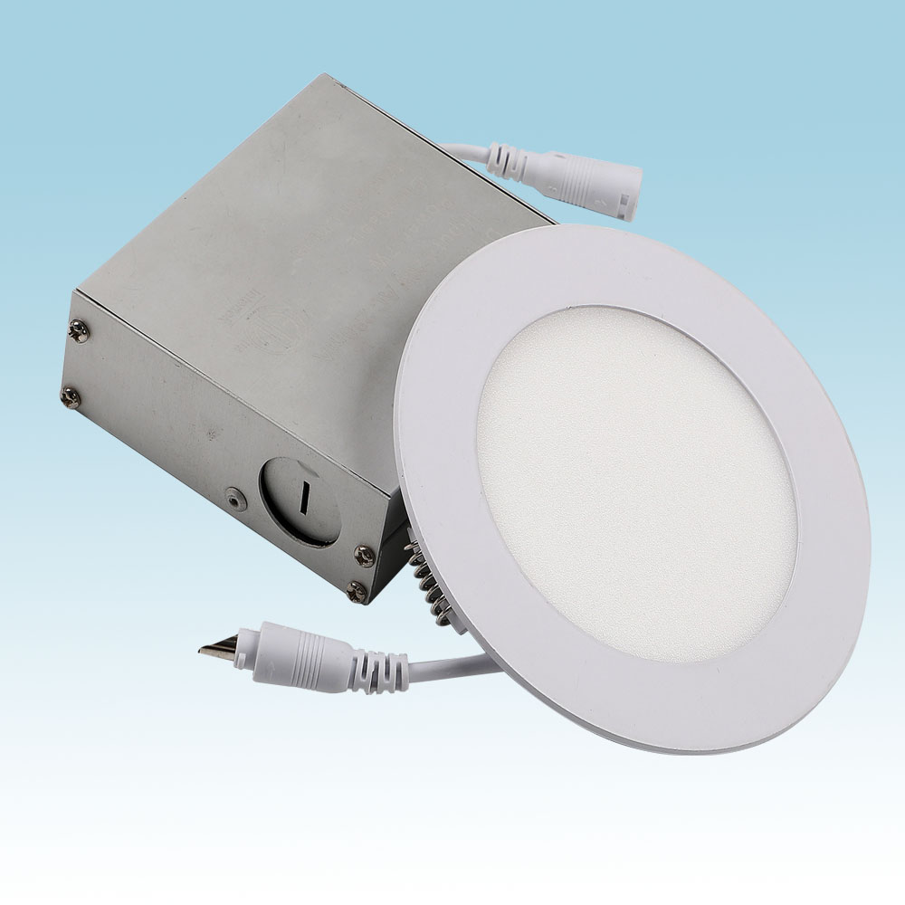
PLR05
Material:Iron base+ PMMA Cover
Input Voltage:AC85-265V
Led Chip:2835SMD
IP Rating:IP44 CRI>80 PF>0.9
Color Temperature:3000K/4500K/6000K
Operating Temperature:-25℃ ~50℃
Life Span:50000hours
Certificate:CE ROHS
Item Number | Wattage | LedQuantity | LuminousFlux | Beam Angle | Size (mm) | Open size（mm)
PLR05 | 3W | 6pcs2835SMD | 240-270lm | 120° | Φ85 | Φ68
 | 6W | 12pcs2835SMD | 480-540lm | 120° | Φ120 | Φ105
 | 9W | 18pcs2835SMD | 630-810lm | 120° | Φ145 | Φ125
 | 12W | 24pcs2835SMD | 960-1080lm | 120° | Φ170 | Φ150
 | 15W | 30pcs2835SMD | 1200-1350lm | 120° | Φ190 | Φ170
 | 18W | 36pcs2835SMD | 1440-1620lm | 120° | Φ220 | Φ200
 | 24W | 48pcs2835SMD | 1920-2160lm | 120° | Φ300 | Φ280
 | 30W | 60pcs2835SMD | 2400-2700lm | 120° | Φ300 | Φ280
Modern Ceiling Light Material:Iron base+ PMMA Cover Input Voltage:AC85-265V Led Chip:2835SMD IP Rating:IP44 CRI>80 PF>0.9 Color Temperature:3000K/4500K/6000K Operating Temperature:-25℃ ~50℃ Life Span:50000hours Certificate:CE ROHS
Item Number | Wattage | LedQuantity | LuminousFlux | Beam Angle | Size (mm) | WIFI Control Remte control Switch control Dimmer control
CL-N00 | 24W | 48pcs2835SMD | 1920-2160lm | 120° | 350mm | Yes
 | 36W | 72pcs2835SMD | 2880-3240lm | 120° | 400mm
 | 40W | 80pcs2835SMD | 3200-3600lm | 120° | 450mm
Modern Ceiling Light Material:Iron base+ PMMA Cover Input Voltage:AC85-265V Led Chip:2835SMD IP Rating:IP44 CRI>80 PF>0.9 Color Temperature:3000K/4500K/6000K Operating Temperature:-25℃ ~50℃ Life Span:50000hours Certificate:CE ROHS
Item Number | Wattage | LedQuantity | LuminousFlux | Beam Angle | Size (mm) | WIFI Control Remte control Switch control Dimmer control
CL-N00 | 24W | 48pcs2835SMD | 1920-2160lm | 120° | 350mm | Yes
 | 36W | 72pcs2835SMD | 2880-3240lm | 120° | 400mm
 | 40W | 80pcs2835SMD | 3200-3600lm | 120° | 450mm
Modern Ceiling Light Material:Iron base+ PMMA Cover Input Voltage:AC85-265V Led Chip:2835SMD IP Rating:IP44 CRI>80 PF>0.9 Color Temperature:3000K/4500K/6000K Operating Temperature:-25℃ ~50℃ Life Span:50000hours Certificate:CE ROHS
Item Number | Wattage | LedQuantity | LuminousFlux | Beam Angle | Size (mm) | WIFI Control Remte control Switch control Dimmer control
CL-N00 | 24W | 48pcs2835SMD | 1920-2160lm | 120° | 350mm | Yes
 | 36W | 72pcs2835SMD | 2880-3240lm | 120° | 400mm
 | 40W | 80pcs2835SMD | 3200-3600lm | 120° | 450mm
Modern Ceiling Light Material:Iron base+ PMMA Cover Input Voltage:AC85-265V Led Chip:2835SMD IP Rating:IP44 CRI>80 PF>0.9 Color Temperature:3000K/4500K/6000K Operating Temperature:-25℃ ~50℃ Life Span:50000hours Certificate:CE ROHS
Item Number | Wattage | LedQuantity | LuminousFlux | Beam Angle | Size (mm) | WIFI Control Remte control Switch control Dimmer control
CL-N00 | 24W | 48pcs2835SMD | 1920-2160lm | 120° | 350mm | Yes
 | 36W | 72pcs2835SMD | 2880-3240lm | 120° | 400mm
 | 40W | 80pcs2835SMD | 3200-3600lm | 120° | 450mm

Slide 9
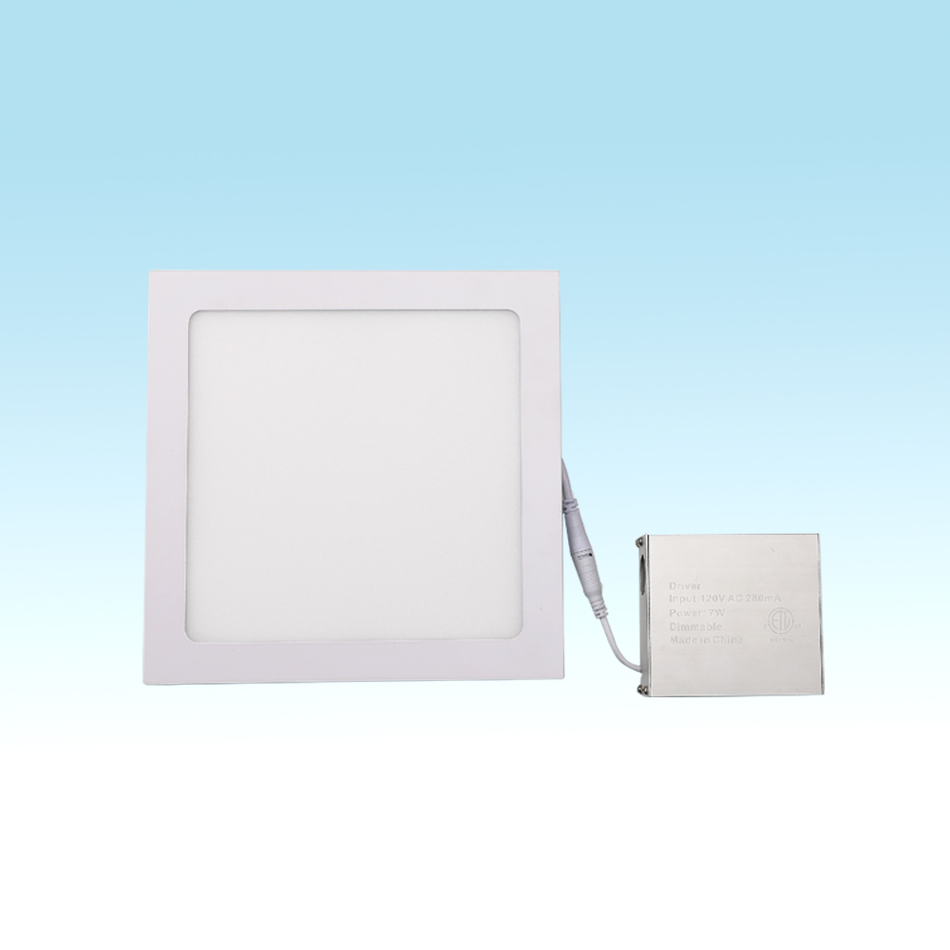
PLS05
Material:Iron base+ PMMA Cover
Input Voltage:AC85-265V
Led Chip:2835SMD
IP Rating:IP44 CRI>80 PF>0.9
Color Temperature:3000K/4500K/6000K
Operating Temperature:-25℃ ~50℃
Life Span:50000hours
Certificate:CE ROHS
Item Number | Wattage | LedQuantity | LuminousFlux | Beam Angle | Size (mm) | Open size（mm)
PLS05 | 3W | 6pcs2835SMD | 240-270lm | 120° | Φ85 | Φ68
 | 6W | 12pcs2835SMD | 480-540lm | 120° | Φ120 | Φ105
 | 9W | 18pcs2835SMD | 630-810lm | 120° | Φ145 | Φ125
 | 12W | 24pcs2835SMD | 960-1080lm | 120° | Φ170 | Φ150
 | 15W | 30pcs2835SMD | 1200-1350lm | 120° | Φ190 | Φ170
 | 18W | 36pcs2835SMD | 1440-1620lm | 120° | Φ220 | Φ200
 | 24W | 48pcs2835SMD | 1920-2160lm | 120° | Φ300 | Φ280
 | 30W | 60pcs2835SMD | 2400-2700lm | 120° | Φ300 | Φ280
Modern Ceiling Light Material:Iron base+ PMMA Cover Input Voltage:AC85-265V Led Chip:2835SMD IP Rating:IP44 CRI>80 PF>0.9 Color Temperature:3000K/4500K/6000K Operating Temperature:-25℃ ~50℃ Life Span:50000hours Certificate:CE ROHS
Item Number | Wattage | LedQuantity | LuminousFlux | Beam Angle | Size (mm) | WIFI Control Remte control Switch control Dimmer control
CL-N00 | 24W | 48pcs2835SMD | 1920-2160lm | 120° | 350mm | Yes
 | 36W | 72pcs2835SMD | 2880-3240lm | 120° | 400mm
 | 40W | 80pcs2835SMD | 3200-3600lm | 120° | 450mm
Modern Ceiling Light Material:Iron base+ PMMA Cover Input Voltage:AC85-265V Led Chip:2835SMD IP Rating:IP44 CRI>80 PF>0.9 Color Temperature:3000K/4500K/6000K Operating Temperature:-25℃ ~50℃ Life Span:50000hours Certificate:CE ROHS
Item Number | Wattage | LedQuantity | LuminousFlux | Beam Angle | Size (mm) | WIFI Control Remte control Switch control Dimmer control
CL-N00 | 24W | 48pcs2835SMD | 1920-2160lm | 120° | 350mm | Yes
 | 36W | 72pcs2835SMD | 2880-3240lm | 120° | 400mm
 | 40W | 80pcs2835SMD | 3200-3600lm | 120° | 450mm
Modern Ceiling Light Material:Iron base+ PMMA Cover Input Voltage:AC85-265V Led Chip:2835SMD IP Rating:IP44 CRI>80 PF>0.9 Color Temperature:3000K/4500K/6000K Operating Temperature:-25℃ ~50℃ Life Span:50000hours Certificate:CE ROHS
Item Number | Wattage | LedQuantity | LuminousFlux | Beam Angle | Size (mm) | WIFI Control Remte control Switch control Dimmer control
CL-N00 | 24W | 48pcs2835SMD | 1920-2160lm | 120° | 350mm | Yes
 | 36W | 72pcs2835SMD | 2880-3240lm | 120° | 400mm
 | 40W | 80pcs2835SMD | 3200-3600lm | 120° | 450mm
Modern Ceiling Light Material:Iron base+ PMMA Cover Input Voltage:AC85-265V Led Chip:2835SMD IP Rating:IP44 CRI>80 PF>0.9 Color Temperature:3000K/4500K/6000K Operating Temperature:-25℃ ~50℃ Life Span:50000hours Certificate:CE ROHS
Item Number | Wattage | LedQuantity | LuminousFlux | Beam Angle | Size (mm) | WIFI Control Remte control Switch control Dimmer control
CL-N00 | 24W | 48pcs2835SMD | 1920-2160lm | 120° | 350mm | Yes
 | 36W | 72pcs2835SMD | 2880-3240lm | 120° | 400mm
 | 40W | 80pcs2835SMD | 3200-3600lm | 120° | 450mm

Slide 10
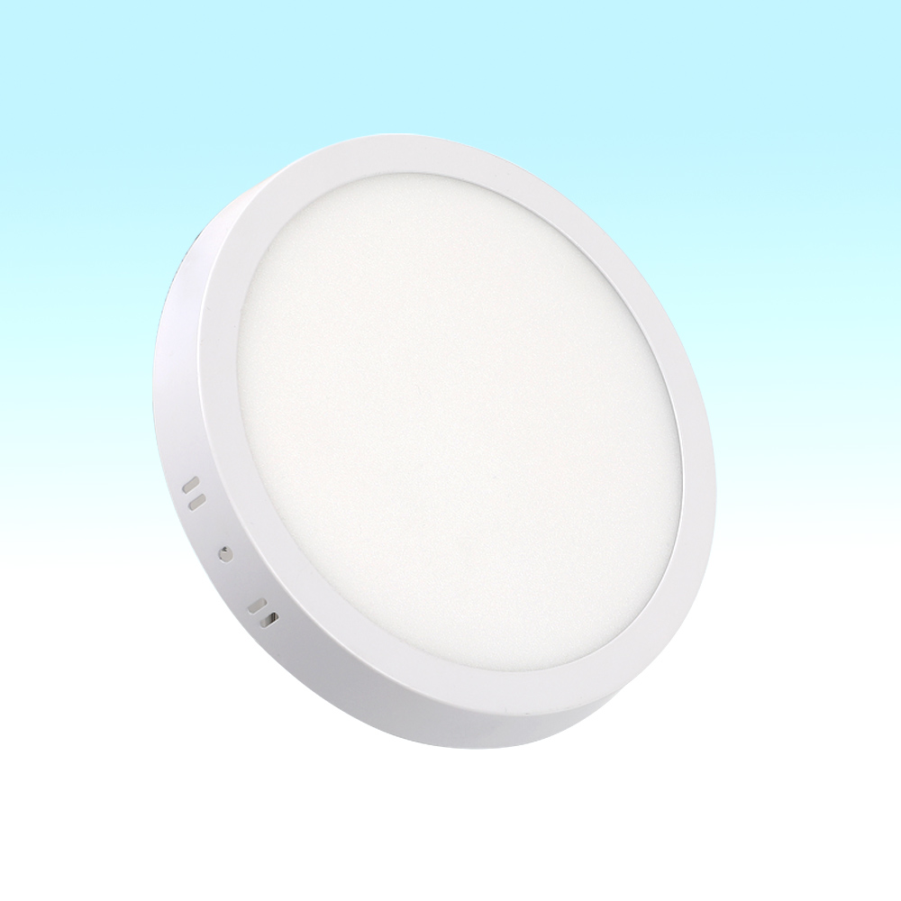
PL06-R
Material:Iron base+ PMMA Cover
Input Voltage:AC85-265V
Led Chip:2835SMD
IP Rating:IP44 CRI>80 PF>0.9
Color Temperature:3000K/4500K/6000K
Operating Temperature:-25℃ ~50℃
Life Span:50000hours
Certificate:CE ROHS
Item Number | Wattage | LedQuantity | LuminousFlux | Beam Angle | Size (mm)
PL06-R | 6W | 12pcs2835SMD | 480-540lm | 120° | Φ110
 | 12W | 24pcs2835SMD | 960-1080lm | 120° | Φ160
 | 18W | 36pcs2835SMD | 1440-1620lm | 120° | Φ210
 | 24W | 48pcs2835SMD | 1920-2160lm | 120° | Φ285
Modern Ceiling Light Material:Iron base+ PMMA Cover Input Voltage:AC85-265V Led Chip:2835SMD IP Rating:IP44 CRI>80 PF>0.9 Color Temperature:3000K/4500K/6000K Operating Temperature:-25℃ ~50℃ Life Span:50000hours Certificate:CE ROHS
Item Number | Wattage | LedQuantity | LuminousFlux | Beam Angle | Size (mm) | WIFI Control Remte control Switch control Dimmer control
CL-N00 | 24W | 48pcs2835SMD | 1920-2160lm | 120° | 350mm | Yes
 | 36W | 72pcs2835SMD | 2880-3240lm | 120° | 400mm
 | 40W | 80pcs2835SMD | 3200-3600lm | 120° | 450mm
Modern Ceiling Light Material:Iron base+ PMMA Cover Input Voltage:AC85-265V Led Chip:2835SMD IP Rating:IP44 CRI>80 PF>0.9 Color Temperature:3000K/4500K/6000K Operating Temperature:-25℃ ~50℃ Life Span:50000hours Certificate:CE ROHS
Item Number | Wattage | LedQuantity | LuminousFlux | Beam Angle | Size (mm) | WIFI Control Remte control Switch control Dimmer control
CL-N00 | 24W | 48pcs2835SMD | 1920-2160lm | 120° | 350mm | Yes
 | 36W | 72pcs2835SMD | 2880-3240lm | 120° | 400mm
 | 40W | 80pcs2835SMD | 3200-3600lm | 120° | 450mm
Modern Ceiling Light Material:Iron base+ PMMA Cover Input Voltage:AC85-265V Led Chip:2835SMD IP Rating:IP44 CRI>80 PF>0.9 Color Temperature:3000K/4500K/6000K Operating Temperature:-25℃ ~50℃ Life Span:50000hours Certificate:CE ROHS
Item Number | Wattage | LedQuantity | LuminousFlux | Beam Angle | Size (mm) | WIFI Control Remte control Switch control Dimmer control
CL-N00 | 24W | 48pcs2835SMD | 1920-2160lm | 120° | 350mm | Yes
 | 36W | 72pcs2835SMD | 2880-3240lm | 120° | 400mm
 | 40W | 80pcs2835SMD | 3200-3600lm | 120° | 450mm
Modern Ceiling Light Material:Iron base+ PMMA Cover Input Voltage:AC85-265V Led Chip:2835SMD IP Rating:IP44 CRI>80 PF>0.9 Color Temperature:3000K/4500K/6000K Operating Temperature:-25℃ ~50℃ Life Span:50000hours Certificate:CE ROHS
Item Number | Wattage | LedQuantity | LuminousFlux | Beam Angle | Size (mm) | WIFI Control Remte control Switch control Dimmer control
CL-N00 | 24W | 48pcs2835SMD | 1920-2160lm | 120° | 350mm | Yes
 | 36W | 72pcs2835SMD | 2880-3240lm | 120° | 400mm
 | 40W | 80pcs2835SMD | 3200-3600lm | 120° | 450mm

Slide 11
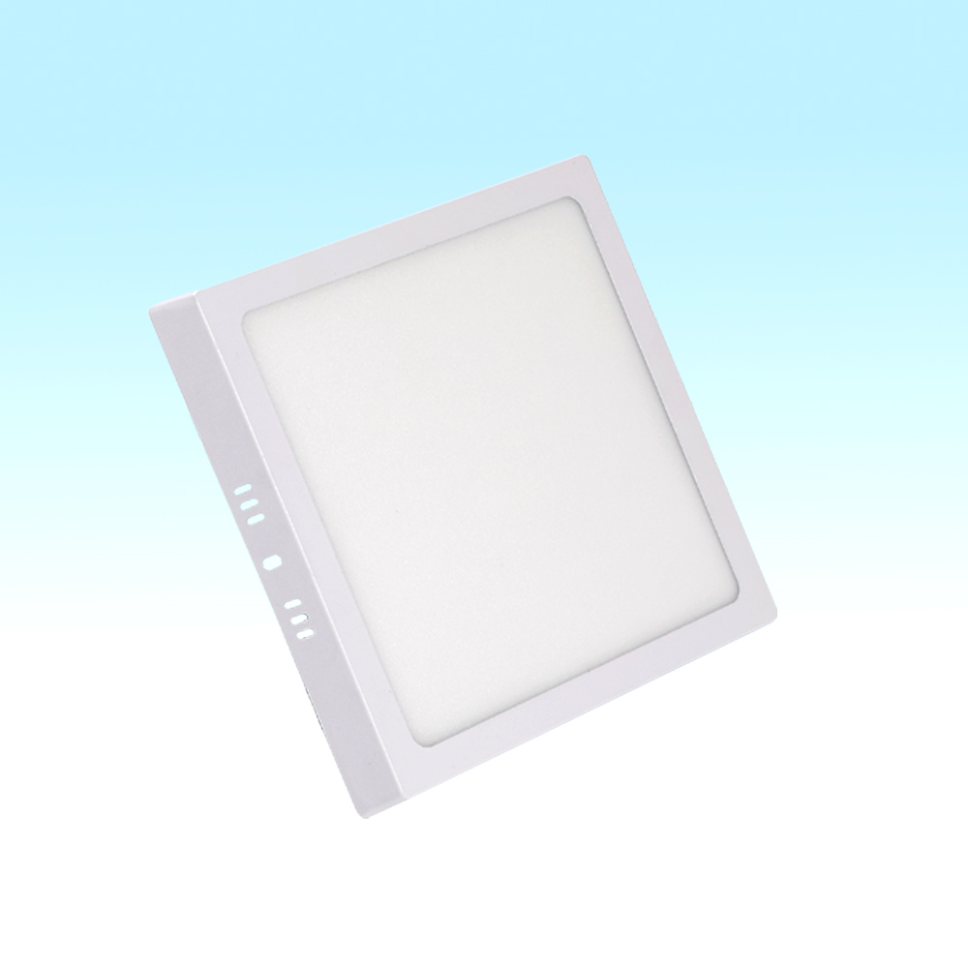
PL06-S
Material:Iron base+ PMMA Cover
Input Voltage:AC85-265V
Led Chip:2835SMD
IP Rating:IP44 CRI>80 PF>0.9
Color Temperature:3000K/4500K/6000K
Operating Temperature:-25℃ ~50℃
Life Span:50000hours
Certificate:CE ROHS
Item Number | Wattage | LedQuantity | LuminousFlux | Beam Angle | Size (mm)
PL06-S | 6W | 12pcs2835SMD | 480-540lm | 120° | Φ110
 | 12W | 24pcs2835SMD | 960-1080lm | 120° | Φ160
 | 18W | 36pcs2835SMD | 1440-1620lm | 120° | Φ210
 | 24W | 48pcs2835SMD | 1920-2160lm | 120° | Φ285
Modern Ceiling Light Material:Iron base+ PMMA Cover Input Voltage:AC85-265V Led Chip:2835SMD IP Rating:IP44 CRI>80 PF>0.9 Color Temperature:3000K/4500K/6000K Operating Temperature:-25℃ ~50℃ Life Span:50000hours Certificate:CE ROHS
Item Number | Wattage | LedQuantity | LuminousFlux | Beam Angle | Size (mm) | WIFI Control Remte control Switch control Dimmer control
CL-N00 | 24W | 48pcs2835SMD | 1920-2160lm | 120° | 350mm | Yes
 | 36W | 72pcs2835SMD | 2880-3240lm | 120° | 400mm
 | 40W | 80pcs2835SMD | 3200-3600lm | 120° | 450mm
Modern Ceiling Light Material:Iron base+ PMMA Cover Input Voltage:AC85-265V Led Chip:2835SMD IP Rating:IP44 CRI>80 PF>0.9 Color Temperature:3000K/4500K/6000K Operating Temperature:-25℃ ~50℃ Life Span:50000hours Certificate:CE ROHS
Item Number | Wattage | LedQuantity | LuminousFlux | Beam Angle | Size (mm) | WIFI Control Remte control Switch control Dimmer control
CL-N00 | 24W | 48pcs2835SMD | 1920-2160lm | 120° | 350mm | Yes
 | 36W | 72pcs2835SMD | 2880-3240lm | 120° | 400mm
 | 40W | 80pcs2835SMD | 3200-3600lm | 120° | 450mm
Modern Ceiling Light Material:Iron base+ PMMA Cover Input Voltage:AC85-265V Led Chip:2835SMD IP Rating:IP44 CRI>80 PF>0.9 Color Temperature:3000K/4500K/6000K Operating Temperature:-25℃ ~50℃ Life Span:50000hours Certificate:CE ROHS
Item Number | Wattage | LedQuantity | LuminousFlux | Beam Angle | Size (mm) | WIFI Control Remte control Switch control Dimmer control
CL-N00 | 24W | 48pcs2835SMD | 1920-2160lm | 120° | 350mm | Yes
 | 36W | 72pcs2835SMD | 2880-3240lm | 120° | 400mm
 | 40W | 80pcs2835SMD | 3200-3600lm | 120° | 450mm
Modern Ceiling Light Material:Iron base+ PMMA Cover Input Voltage:AC85-265V Led Chip:2835SMD IP Rating:IP44 CRI>80 PF>0.9 Color Temperature:3000K/4500K/6000K Operating Temperature:-25℃ ~50℃ Life Span:50000hours Certificate:CE ROHS
Item Number | Wattage | LedQuantity | LuminousFlux | Beam Angle | Size (mm) | WIFI Control Remte control Switch control Dimmer control
CL-N00 | 24W | 48pcs2835SMD | 1920-2160lm | 120° | 350mm | Yes
 | 36W | 72pcs2835SMD | 2880-3240lm | 120° | 400mm
 | 40W | 80pcs2835SMD | 3200-3600lm | 120° | 450mm

Slide 12
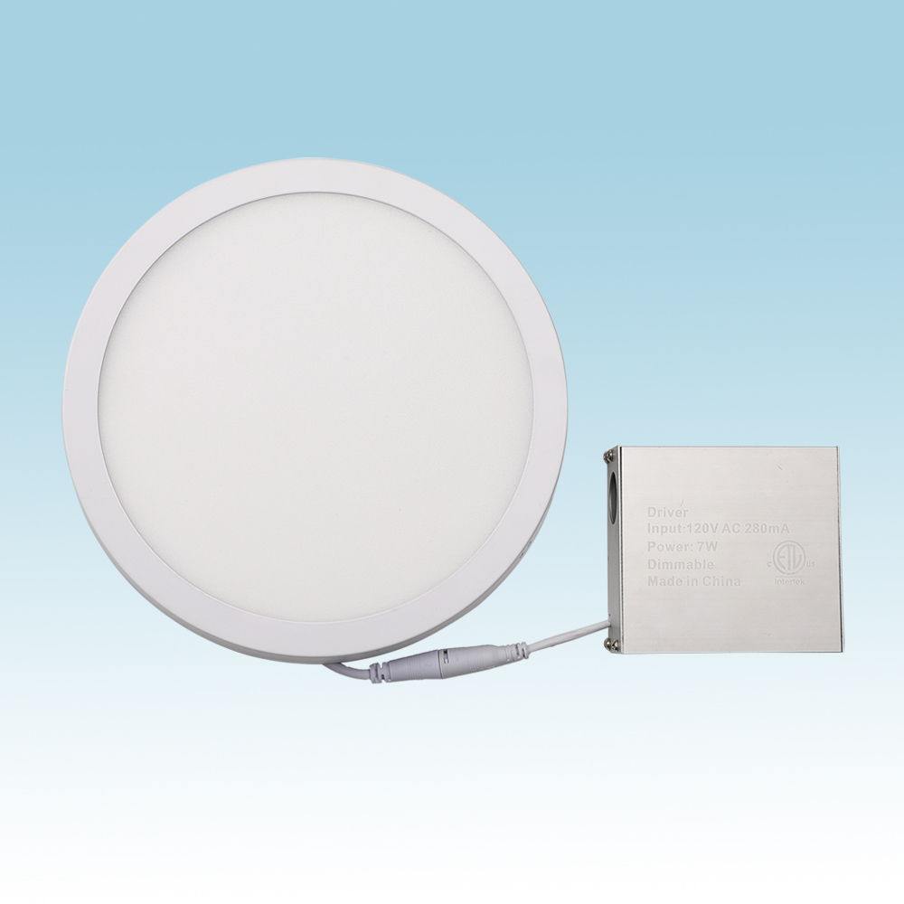
PRL06
Material:Iron base+ PMMA Cover
Input Voltage:AC85-265V
Led Chip:2835SMD
IP Rating:IP44 CRI>80 PF>0.9
Color Temperature:3000K/4500K/6000K
Operating Temperature:-25℃ ~50℃
Life Span:50000hours
Certificate:CE ROHS
Item Number | Wattage | LedQuantity | LuminousFlux | Beam Angle | Size (mm)
PRL06 | 6W | 12pcs2835SMD | 480-540lm | 120° | Φ110
 | 12W | 24pcs2835SMD | 960-1080lm | 120° | Φ160
 | 18W | 36pcs2835SMD | 1440-1620lm | 120° | Φ210
 | 24W | 48pcs2835SMD | 1920-2160lm | 120° | Φ285
Modern Ceiling Light Material:Iron base+ PMMA Cover Input Voltage:AC85-265V Led Chip:2835SMD IP Rating:IP44 CRI>80 PF>0.9 Color Temperature:3000K/4500K/6000K Operating Temperature:-25℃ ~50℃ Life Span:50000hours Certificate:CE ROHS
Item Number | Wattage | LedQuantity | LuminousFlux | Beam Angle | Size (mm) | WIFI Control Remte control Switch control Dimmer control
CL-N00 | 24W | 48pcs2835SMD | 1920-2160lm | 120° | 350mm | Yes
 | 36W | 72pcs2835SMD | 2880-3240lm | 120° | 400mm
 | 40W | 80pcs2835SMD | 3200-3600lm | 120° | 450mm
Modern Ceiling Light Material:Iron base+ PMMA Cover Input Voltage:AC85-265V Led Chip:2835SMD IP Rating:IP44 CRI>80 PF>0.9 Color Temperature:3000K/4500K/6000K Operating Temperature:-25℃ ~50℃ Life Span:50000hours Certificate:CE ROHS
Item Number | Wattage | LedQuantity | LuminousFlux | Beam Angle | Size (mm) | WIFI Control Remte control Switch control Dimmer control
CL-N00 | 24W | 48pcs2835SMD | 1920-2160lm | 120° | 350mm | Yes
 | 36W | 72pcs2835SMD | 2880-3240lm | 120° | 400mm
 | 40W | 80pcs2835SMD | 3200-3600lm | 120° | 450mm
Modern Ceiling Light Material:Iron base+ PMMA Cover Input Voltage:AC85-265V Led Chip:2835SMD IP Rating:IP44 CRI>80 PF>0.9 Color Temperature:3000K/4500K/6000K Operating Temperature:-25℃ ~50℃ Life Span:50000hours Certificate:CE ROHS
Item Number | Wattage | LedQuantity | LuminousFlux | Beam Angle | Size (mm) | WIFI Control Remte control Switch control Dimmer control
CL-N00 | 24W | 48pcs2835SMD | 1920-2160lm | 120° | 350mm | Yes
 | 36W | 72pcs2835SMD | 2880-3240lm | 120° | 400mm
 | 40W | 80pcs2835SMD | 3200-3600lm | 120° | 450mm
Modern Ceiling Light Material:Iron base+ PMMA Cover Input Voltage:AC85-265V Led Chip:2835SMD IP Rating:IP44 CRI>80 PF>0.9 Color Temperature:3000K/4500K/6000K Operating Temperature:-25℃ ~50℃ Life Span:50000hours Certificate:CE ROHS
Item Number | Wattage | LedQuantity | LuminousFlux | Beam Angle | Size (mm) | WIFI Control Remte control Switch control Dimmer control
CL-N00 | 24W | 48pcs2835SMD | 1920-2160lm | 120° | 350mm | Yes
 | 36W | 72pcs2835SMD | 2880-3240lm | 120° | 400mm
 | 40W | 80pcs2835SMD | 3200-3600lm | 120° | 450mm

Slide 13
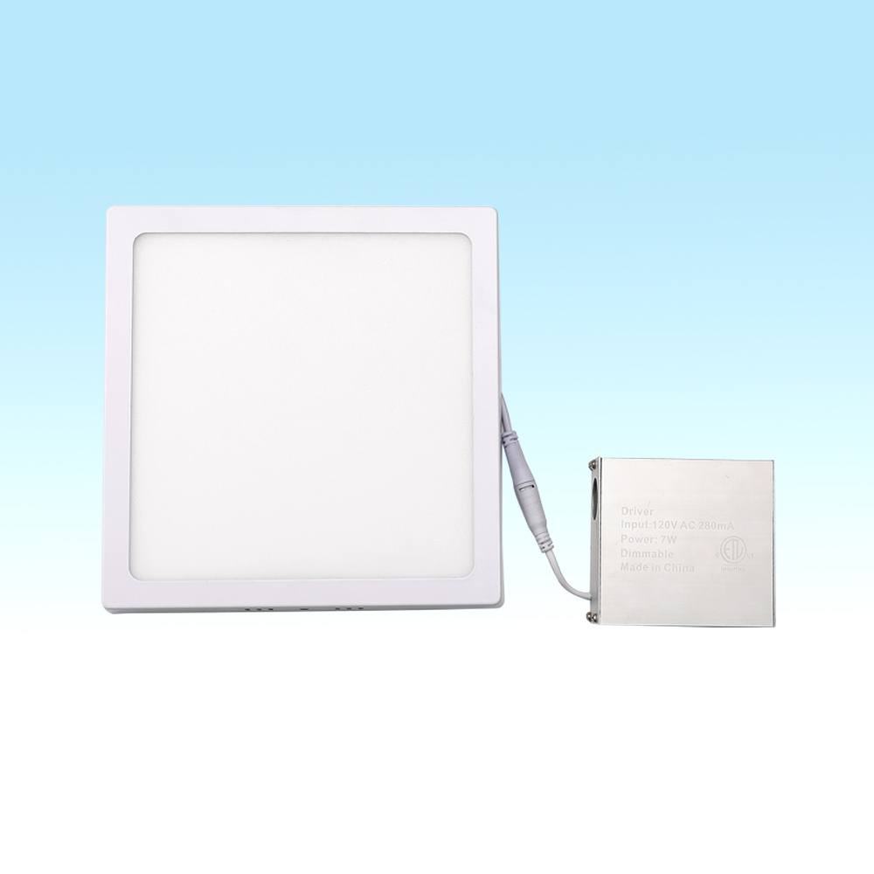
PSL06
Material:Iron base+ PMMA Cover
Input Voltage:AC85-265V
Led Chip:2835SMD
IP Rating:IP44 CRI>80 PF>0.9
Color Temperature:3000K/4500K/6000K
Operating Temperature:-25℃ ~50℃
Life Span:50000hours
Certificate:CE ROHS
Item Number | Wattage | LedQuantity | LuminousFlux | Beam Angle | Size (mm)
PSL06 | 6W | 12pcs2835SMD | 480-540lm | 120° | Φ110
 | 12W | 24pcs2835SMD | 960-1080lm | 120° | Φ160
 | 18W | 36pcs2835SMD | 1440-1620lm | 120° | Φ210
 | 24W | 48pcs2835SMD | 1920-2160lm | 120° | Φ285
Modern Ceiling Light Material:Iron base+ PMMA Cover Input Voltage:AC85-265V Led Chip:2835SMD IP Rating:IP44 CRI>80 PF>0.9 Color Temperature:3000K/4500K/6000K Operating Temperature:-25℃ ~50℃ Life Span:50000hours Certificate:CE ROHS
Item Number | Wattage | LedQuantity | LuminousFlux | Beam Angle | Size (mm) | WIFI Control Remte control Switch control Dimmer control
CL-N00 | 24W | 48pcs2835SMD | 1920-2160lm | 120° | 350mm | Yes
 | 36W | 72pcs2835SMD | 2880-3240lm | 120° | 400mm
 | 40W | 80pcs2835SMD | 3200-3600lm | 120° | 450mm
Modern Ceiling Light Material:Iron base+ PMMA Cover Input Voltage:AC85-265V Led Chip:2835SMD IP Rating:IP44 CRI>80 PF>0.9 Color Temperature:3000K/4500K/6000K Operating Temperature:-25℃ ~50℃ Life Span:50000hours Certificate:CE ROHS
Item Number | Wattage | LedQuantity | LuminousFlux | Beam Angle | Size (mm) | WIFI Control Remte control Switch control Dimmer control
CL-N00 | 24W | 48pcs2835SMD | 1920-2160lm | 120° | 350mm | Yes
 | 36W | 72pcs2835SMD | 2880-3240lm | 120° | 400mm
 | 40W | 80pcs2835SMD | 3200-3600lm | 120° | 450mm
Modern Ceiling Light Material:Iron base+ PMMA Cover Input Voltage:AC85-265V Led Chip:2835SMD IP Rating:IP44 CRI>80 PF>0.9 Color Temperature:3000K/4500K/6000K Operating Temperature:-25℃ ~50℃ Life Span:50000hours Certificate:CE ROHS
Item Number | Wattage | LedQuantity | LuminousFlux | Beam Angle | Size (mm) | WIFI Control Remte control Switch control Dimmer control
CL-N00 | 24W | 48pcs2835SMD | 1920-2160lm | 120° | 350mm | Yes
 | 36W | 72pcs2835SMD | 2880-3240lm | 120° | 400mm
 | 40W | 80pcs2835SMD | 3200-3600lm | 120° | 450mm
Modern Ceiling Light Material:Iron base+ PMMA Cover Input Voltage:AC85-265V Led Chip:2835SMD IP Rating:IP44 CRI>80 PF>0.9 Color Temperature:3000K/4500K/6000K Operating Temperature:-25℃ ~50℃ Life Span:50000hours Certificate:CE ROHS
Item Number | Wattage | LedQuantity | LuminousFlux | Beam Angle | Size (mm) | WIFI Control Remte control Switch control Dimmer control
CL-N00 | 24W | 48pcs2835SMD | 1920-2160lm | 120° | 350mm | Yes
 | 36W | 72pcs2835SMD | 2880-3240lm | 120° | 400mm
 | 40W | 80pcs2835SMD | 3200-3600lm | 120° | 450mm

Slide 14
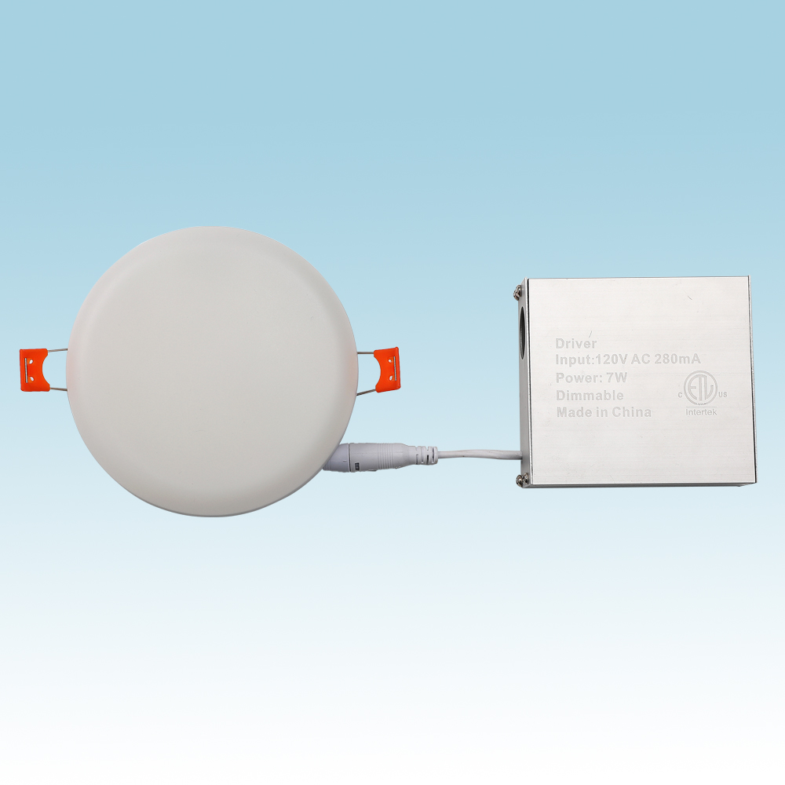
PRL07
Material:Iron base+ PMMA Cover
Input Voltage:AC85-265V
Led Chip:2835SMD
IP Rating:IP44 CRI>80 PF>0.9
Color Temperature:3000K/4500K/6000K
Operating Temperature:-25℃ ~50℃
Life Span:50000hours
Certificate:CE ROHS
Item Number | Wattage | Led Quantity | Luminous Flux | Beam Angle | Size (mm)
PRL07 | 6W | 12pcs2835SMD | 480-540lm | 120° | Φ110
 | 12W | 24pcs2835SMD | 960-1080lm | 120° | Φ160
 | 18W | 36pcs2835SMD | 1440-1620lm | 120° | Φ210
 | 24W | 48pcs2835SMD | 1920-2160lm | 120° | Φ285
Modern Ceiling Light Material:Iron base+ PMMA Cover Input Voltage:AC85-265V Led Chip:2835SMD IP Rating:IP44 CRI>80 PF>0.9 Color Temperature:3000K/4500K/6000K Operating Temperature:-25℃ ~50℃ Life Span:50000hours Certificate:CE ROHS
Item Number | Wattage | LedQuantity | LuminousFlux | Beam Angle | Size (mm) | WIFI Control Remte control Switch control Dimmer control
CL-N00 | 24W | 48pcs2835SMD | 1920-2160lm | 120° | 350mm | Yes
 | 36W | 72pcs2835SMD | 2880-3240lm | 120° | 400mm
 | 40W | 80pcs2835SMD | 3200-3600lm | 120° | 450mm
Modern Ceiling Light Material:Iron base+ PMMA Cover Input Voltage:AC85-265V Led Chip:2835SMD IP Rating:IP44 CRI>80 PF>0.9 Color Temperature:3000K/4500K/6000K Operating Temperature:-25℃ ~50℃ Life Span:50000hours Certificate:CE ROHS
Item Number | Wattage | LedQuantity | LuminousFlux | Beam Angle | Size (mm) | WIFI Control Remte control Switch control Dimmer control
CL-N00 | 24W | 48pcs2835SMD | 1920-2160lm | 120° | 350mm | Yes
 | 36W | 72pcs2835SMD | 2880-3240lm | 120° | 400mm
 | 40W | 80pcs2835SMD | 3200-3600lm | 120° | 450mm
Modern Ceiling Light Material:Iron base+ PMMA Cover Input Voltage:AC85-265V Led Chip:2835SMD IP Rating:IP44 CRI>80 PF>0.9 Color Temperature:3000K/4500K/6000K Operating Temperature:-25℃ ~50℃ Life Span:50000hours Certificate:CE ROHS
Item Number | Wattage | LedQuantity | LuminousFlux | Beam Angle | Size (mm) | WIFI Control Remte control Switch control Dimmer control
CL-N00 | 24W | 48pcs2835SMD | 1920-2160lm | 120° | 350mm | Yes
 | 36W | 72pcs2835SMD | 2880-3240lm | 120° | 400mm
 | 40W | 80pcs2835SMD | 3200-3600lm | 120° | 450mm
Modern Ceiling Light Material:Iron base+ PMMA Cover Input Voltage:AC85-265V Led Chip:2835SMD IP Rating:IP44 CRI>80 PF>0.9 Color Temperature:3000K/4500K/6000K Operating Temperature:-25℃ ~50℃ Life Span:50000hours Certificate:CE ROHS
Item Number | Wattage | LedQuantity | LuminousFlux | Beam Angle | Size (mm) | WIFI Control Remte control Switch control Dimmer control
CL-N00 | 24W | 48pcs2835SMD | 1920-2160lm | 120° | 350mm | Yes
 | 36W | 72pcs2835SMD | 2880-3240lm | 120° | 400mm
 | 40W | 80pcs2835SMD | 3200-3600lm | 120° | 450mm

Slide 15
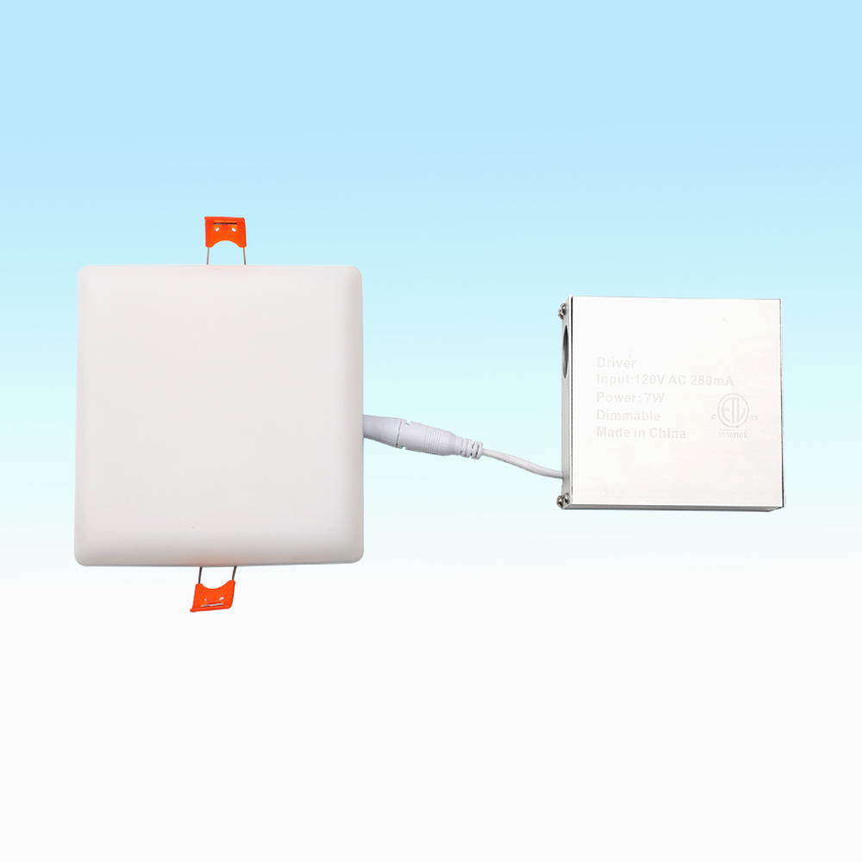
PSL07
Material:Iron base+ PMMA Cover
Input Voltage:AC85-265V
Led Chip:2835SMD
IP Rating:IP44 CRI>80 PF>0.9
Color Temperature:3000K/4500K/6000K
Operating Temperature:-25℃ ~50℃
Life Span:50000hours
Certificate:CE ROHS
Item Number | Wattage | Led Quantity | Luminous Flux | Beam Angle | Size (mm)
PSL07 | 6W | 12pcs2835SMD | 480-540lm | 120° | Φ110
 | 12W | 24pcs2835SMD | 960-1080lm | 120° | Φ160
 | 18W | 36pcs2835SMD | 1440-1620lm | 120° | Φ210
 | 24W | 48pcs2835SMD | 1920-2160lm | 120° | Φ285
Modern Ceiling Light Material:Iron base+ PMMA Cover Input Voltage:AC85-265V Led Chip:2835SMD IP Rating:IP44 CRI>80 PF>0.9 Color Temperature:3000K/4500K/6000K Operating Temperature:-25℃ ~50℃ Life Span:50000hours Certificate:CE ROHS
Item Number | Wattage | LedQuantity | LuminousFlux | Beam Angle | Size (mm) | WIFI Control Remte control Switch control Dimmer control
CL-N00 | 24W | 48pcs2835SMD | 1920-2160lm | 120° | 350mm | Yes
 | 36W | 72pcs2835SMD | 2880-3240lm | 120° | 400mm
 | 40W | 80pcs2835SMD | 3200-3600lm | 120° | 450mm
Modern Ceiling Light Material:Iron base+ PMMA Cover Input Voltage:AC85-265V Led Chip:2835SMD IP Rating:IP44 CRI>80 PF>0.9 Color Temperature:3000K/4500K/6000K Operating Temperature:-25℃ ~50℃ Life Span:50000hours Certificate:CE ROHS
Item Number | Wattage | LedQuantity | LuminousFlux | Beam Angle | Size (mm) | WIFI Control Remte control Switch control Dimmer control
CL-N00 | 24W | 48pcs2835SMD | 1920-2160lm | 120° | 350mm | Yes
 | 36W | 72pcs2835SMD | 2880-3240lm | 120° | 400mm
 | 40W | 80pcs2835SMD | 3200-3600lm | 120° | 450mm
Modern Ceiling Light Material:Iron base+ PMMA Cover Input Voltage:AC85-265V Led Chip:2835SMD IP Rating:IP44 CRI>80 PF>0.9 Color Temperature:3000K/4500K/6000K Operating Temperature:-25℃ ~50℃ Life Span:50000hours Certificate:CE ROHS
Item Number | Wattage | LedQuantity | LuminousFlux | Beam Angle | Size (mm) | WIFI Control Remte control Switch control Dimmer control
CL-N00 | 24W | 48pcs2835SMD | 1920-2160lm | 120° | 350mm | Yes
 | 36W | 72pcs2835SMD | 2880-3240lm | 120° | 400mm
 | 40W | 80pcs2835SMD | 3200-3600lm | 120° | 450mm
Modern Ceiling Light Material:Iron base+ PMMA Cover Input Voltage:AC85-265V Led Chip:2835SMD IP Rating:IP44 CRI>80 PF>0.9 Color Temperature:3000K/4500K/6000K Operating Temperature:-25℃ ~50℃ Life Span:50000hours Certificate:CE ROHS
Item Number | Wattage | LedQuantity | LuminousFlux | Beam Angle | Size (mm) | WIFI Control Remte control Switch control Dimmer control
CL-N00 | 24W | 48pcs2835SMD | 1920-2160lm | 120° | 350mm | Yes
 | 36W | 72pcs2835SMD | 2880-3240lm | 120° | 400mm
 | 40W | 80pcs2835SMD | 3200-3600lm | 120° | 450mm

Slide 16
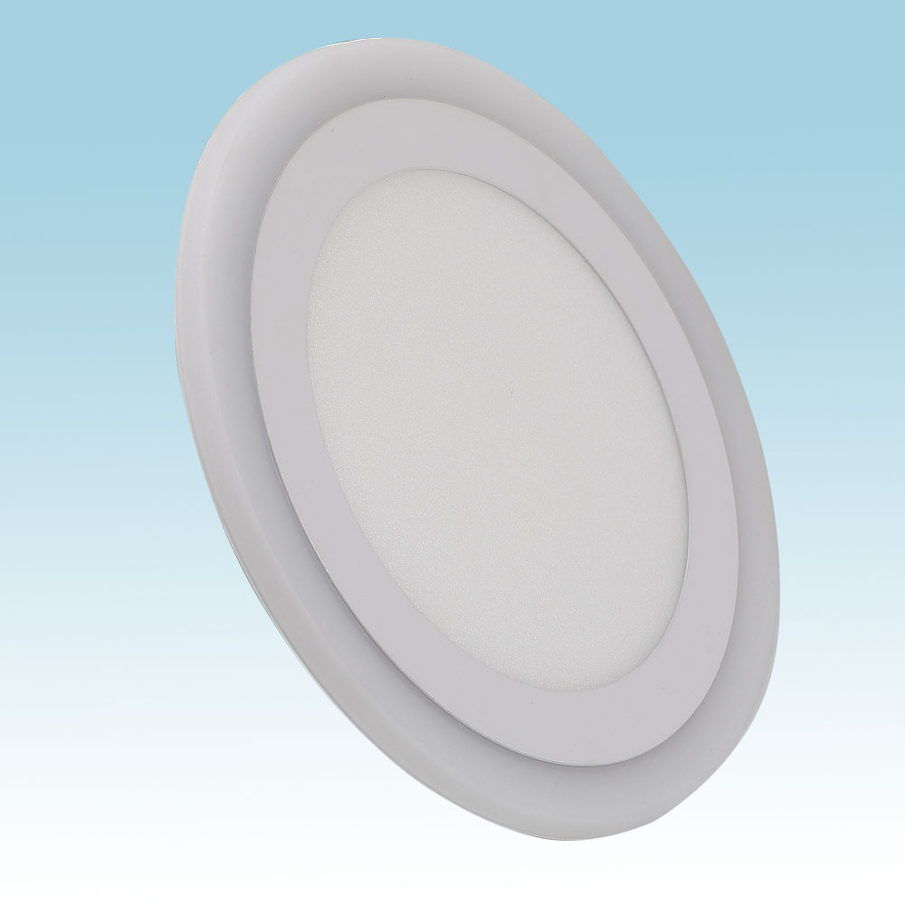
PL08
Material:Iron base+ PMMA Cover
Input Voltage:AC85-265V
Led Chip:2835SMD
IP Rating:IP44 CRI>80 PF>0.9
Color Temperature:3000K/4500K/6000K
Operating Temperature:-25℃ ~50℃
Life Span:50000hours
Certificate:CE ROHS
Item Number | Wattage | LedQuantity | LuminousFlux | Beam Angle | Size (mm)
PL08 | 3+3W | 12pcs2835SMD | 480-540lm | 120° | Φ105
 | 6+3W | 24pcs2835SMD | 960-1080lm | 120° | Φ145
 | 12+6W | 36pcs2835SMD | 1440-1620lm | 120° | Φ195
 | 18+6W | 48pcs2835SMD | 1920-2160lm | 120° | Φ240
Modern Ceiling Light Material:Iron base+ PMMA Cover Input Voltage:AC85-265V Led Chip:2835SMD IP Rating:IP44 CRI>80 PF>0.9 Color Temperature:3000K/4500K/6000K Operating Temperature:-25℃ ~50℃ Life Span:50000hours Certificate:CE ROHS
Item Number | Wattage | LedQuantity | LuminousFlux | Beam Angle | Size (mm) | WIFI Control Remte control Switch control Dimmer control
CL-N00 | 24W | 48pcs2835SMD | 1920-2160lm | 120° | 350mm | Yes
 | 36W | 72pcs2835SMD | 2880-3240lm | 120° | 400mm
 | 40W | 80pcs2835SMD | 3200-3600lm | 120° | 450mm
Modern Ceiling Light Material:Iron base+ PMMA Cover Input Voltage:AC85-265V Led Chip:2835SMD IP Rating:IP44 CRI>80 PF>0.9 Color Temperature:3000K/4500K/6000K Operating Temperature:-25℃ ~50℃ Life Span:50000hours Certificate:CE ROHS
Item Number | Wattage | LedQuantity | LuminousFlux | Beam Angle | Size (mm) | WIFI Control Remte control Switch control Dimmer control
CL-N00 | 24W | 48pcs2835SMD | 1920-2160lm | 120° | 350mm | Yes
 | 36W | 72pcs2835SMD | 2880-3240lm | 120° | 400mm
 | 40W | 80pcs2835SMD | 3200-3600lm | 120° | 450mm
Modern Ceiling Light Material:Iron base+ PMMA Cover Input Voltage:AC85-265V Led Chip:2835SMD IP Rating:IP44 CRI>80 PF>0.9 Color Temperature:3000K/4500K/6000K Operating Temperature:-25℃ ~50℃ Life Span:50000hours Certificate:CE ROHS
Item Number | Wattage | LedQuantity | LuminousFlux | Beam Angle | Size (mm) | WIFI Control Remte control Switch control Dimmer control
CL-N00 | 24W | 48pcs2835SMD | 1920-2160lm | 120° | 350mm | Yes
 | 36W | 72pcs2835SMD | 2880-3240lm | 120° | 400mm
 | 40W | 80pcs2835SMD | 3200-3600lm | 120° | 450mm
Modern Ceiling Light Material:Iron base+ PMMA Cover Input Voltage:AC85-265V Led Chip:2835SMD IP Rating:IP44 CRI>80 PF>0.9 Color Temperature:3000K/4500K/6000K Operating Temperature:-25℃ ~50℃ Life Span:50000hours Certificate:CE ROHS
Item Number | Wattage | LedQuantity | LuminousFlux | Beam Angle | Size (mm) | WIFI Control Remte control Switch control Dimmer control
CL-N00 | 24W | 48pcs2835SMD | 1920-2160lm | 120° | 350mm | Yes
 | 36W | 72pcs2835SMD | 2880-3240lm | 120° | 400mm
 | 40W | 80pcs2835SMD | 3200-3600lm | 120° | 450mm

Slide 17
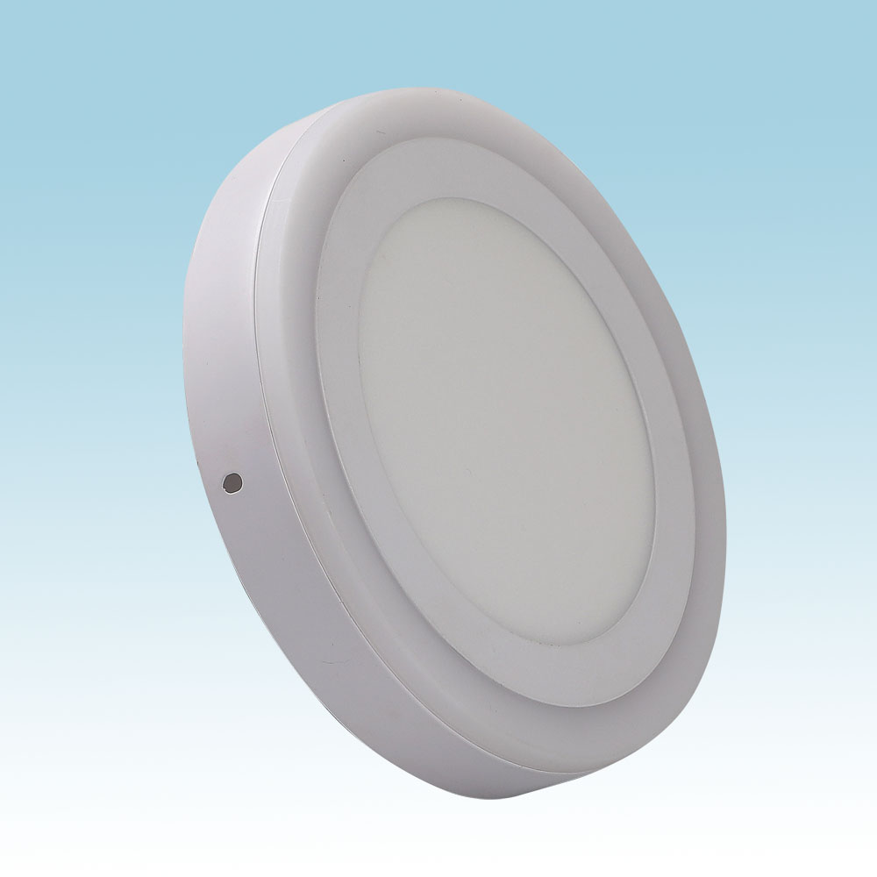
PL09
Material:Iron base+ PMMA Cover
Input Voltage:AC85-265V
Led Chip:2835SMD
IP Rating:IP44 CRI>80 PF>0.9
Color Temperature:3000K/4500K/6000K
Operating Temperature:-25℃ ~50℃
Life Span:50000hours
Certificate:CE ROHS
Item Number | Wattage | Led Quantity | Luminous Flux | Beam Angle | Size (mm)
PL09 | 3+3W | 12pcs2835SMD | 480-540lm | 120° | Φ105
 | 6+3W | 24pcs2835SMD | 960-1080lm | 120° | Φ145
 | 12+6W | 36pcs2835SMD | 1440-1620lm | 120° | Φ195
 | 18+6W | 48pcs2835SMD | 1920-2160lm | 120° | Φ240
Modern Ceiling Light Material:Iron base+ PMMA Cover Input Voltage:AC85-265V Led Chip:2835SMD IP Rating:IP44 CRI>80 PF>0.9 Color Temperature:3000K/4500K/6000K Operating Temperature:-25℃ ~50℃ Life Span:50000hours Certificate:CE ROHS
Item Number | Wattage | LedQuantity | LuminousFlux | Beam Angle | Size (mm) | WIFI Control Remte control Switch control Dimmer control
CL-N00 | 24W | 48pcs2835SMD | 1920-2160lm | 120° | 350mm | Yes
 | 36W | 72pcs2835SMD | 2880-3240lm | 120° | 400mm
 | 40W | 80pcs2835SMD | 3200-3600lm | 120° | 450mm
Modern Ceiling Light Material:Iron base+ PMMA Cover Input Voltage:AC85-265V Led Chip:2835SMD IP Rating:IP44 CRI>80 PF>0.9 Color Temperature:3000K/4500K/6000K Operating Temperature:-25℃ ~50℃ Life Span:50000hours Certificate:CE ROHS
Item Number | Wattage | LedQuantity | LuminousFlux | Beam Angle | Size (mm) | WIFI Control Remte control Switch control Dimmer control
CL-N00 | 24W | 48pcs2835SMD | 1920-2160lm | 120° | 350mm | Yes
 | 36W | 72pcs2835SMD | 2880-3240lm | 120° | 400mm
 | 40W | 80pcs2835SMD | 3200-3600lm | 120° | 450mm
Modern Ceiling Light Material:Iron base+ PMMA Cover Input Voltage:AC85-265V Led Chip:2835SMD IP Rating:IP44 CRI>80 PF>0.9 Color Temperature:3000K/4500K/6000K Operating Temperature:-25℃ ~50℃ Life Span:50000hours Certificate:CE ROHS
Item Number | Wattage | LedQuantity | LuminousFlux | Beam Angle | Size (mm) | WIFI Control Remte control Switch control Dimmer control
CL-N00 | 24W | 48pcs2835SMD | 1920-2160lm | 120° | 350mm | Yes
 | 36W | 72pcs2835SMD | 2880-3240lm | 120° | 400mm
 | 40W | 80pcs2835SMD | 3200-3600lm | 120° | 450mm
Modern Ceiling Light Material:Iron base+ PMMA Cover Input Voltage:AC85-265V Led Chip:2835SMD IP Rating:IP44 CRI>80 PF>0.9 Color Temperature:3000K/4500K/6000K Operating Temperature:-25℃ ~50℃ Life Span:50000hours Certificate:CE ROHS
Item Number | Wattage | LedQuantity | LuminousFlux | Beam Angle | Size (mm) | WIFI Control Remte control Switch control Dimmer control
CL-N00 | 24W | 48pcs2835SMD | 1920-2160lm | 120° | 350mm | Yes
 | 36W | 72pcs2835SMD | 2880-3240lm | 120° | 400mm
 | 40W | 80pcs2835SMD | 3200-3600lm | 120° | 450mm

Slide 18
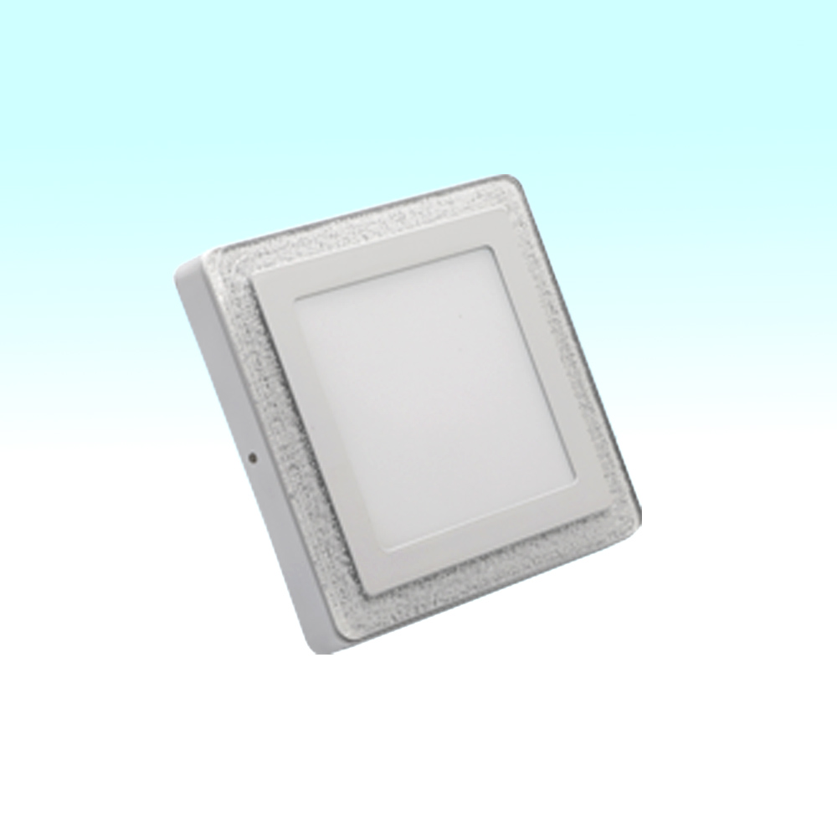
PL10
Material:Iron base+ PMMA Cover
Input Voltage:AC85-265V
Led Chip:2835SMD
IP Rating:IP44 CRI>80 PF>0.9
Color Temperature:3000K/4500K/6000K
Operating Temperature:-25℃ ~50℃
Life Span:50000hours
Certificate:CE ROHS
Item Number | Wattage | Led Quantity | Luminous Flux | Beam Angle | Size (mm)
PL10 | 3+3W | 12pcs2835SMD | 480-540lm | 120° | 105*105
 | 6+3W | 24pcs2835SMD | 960-1080lm | 120° | 145*145
 | 12+6W | 36pcs2835SMD | 1440-1620lm | 120° | 195*195
 | 18+6W | 48pcs2835SMD | 1920-2160lm | 120° | 240*240
Modern Ceiling Light Material:Iron base+ PMMA Cover Input Voltage:AC85-265V Led Chip:2835SMD IP Rating:IP44 CRI>80 PF>0.9 Color Temperature:3000K/4500K/6000K Operating Temperature:-25℃ ~50℃ Life Span:50000hours Certificate:CE ROHS
Item Number | Wattage | LedQuantity | LuminousFlux | Beam Angle | Size (mm) | WIFI Control Remte control Switch control Dimmer control
CL-N00 | 24W | 48pcs2835SMD | 1920-2160lm | 120° | 350mm | Yes
 | 36W | 72pcs2835SMD | 2880-3240lm | 120° | 400mm
 | 40W | 80pcs2835SMD | 3200-3600lm | 120° | 450mm
Modern Ceiling Light Material:Iron base+ PMMA Cover Input Voltage:AC85-265V Led Chip:2835SMD IP Rating:IP44 CRI>80 PF>0.9 Color Temperature:3000K/4500K/6000K Operating Temperature:-25℃ ~50℃ Life Span:50000hours Certificate:CE ROHS
Item Number | Wattage | LedQuantity | LuminousFlux | Beam Angle | Size (mm) | WIFI Control Remte control Switch control Dimmer control
CL-N00 | 24W | 48pcs2835SMD | 1920-2160lm | 120° | 350mm | Yes
 | 36W | 72pcs2835SMD | 2880-3240lm | 120° | 400mm
 | 40W | 80pcs2835SMD | 3200-3600lm | 120° | 450mm
Modern Ceiling Light Material:Iron base+ PMMA Cover Input Voltage:AC85-265V Led Chip:2835SMD IP Rating:IP44 CRI>80 PF>0.9 Color Temperature:3000K/4500K/6000K Operating Temperature:-25℃ ~50℃ Life Span:50000hours Certificate:CE ROHS
Item Number | Wattage | LedQuantity | LuminousFlux | Beam Angle | Size (mm) | WIFI Control Remte control Switch control Dimmer control
CL-N00 | 24W | 48pcs2835SMD | 1920-2160lm | 120° | 350mm | Yes
 | 36W | 72pcs2835SMD | 2880-3240lm | 120° | 400mm
 | 40W | 80pcs2835SMD | 3200-3600lm | 120° | 450mm
Modern Ceiling Light Material:Iron base+ PMMA Cover Input Voltage:AC85-265V Led Chip:2835SMD IP Rating:IP44 CRI>80 PF>0.9 Color Temperature:3000K/4500K/6000K Operating Temperature:-25℃ ~50℃ Life Span:50000hours Certificate:CE ROHS
Item Number | Wattage | LedQuantity | LuminousFlux | Beam Angle | Size (mm) | WIFI Control Remte control Switch control Dimmer control
CL-N00 | 24W | 48pcs2835SMD | 1920-2160lm | 120° | 350mm | Yes
 | 36W | 72pcs2835SMD | 2880-3240lm | 120° | 400mm
 | 40W | 80pcs2835SMD | 3200-3600lm | 120° | 450mm

Slide 19
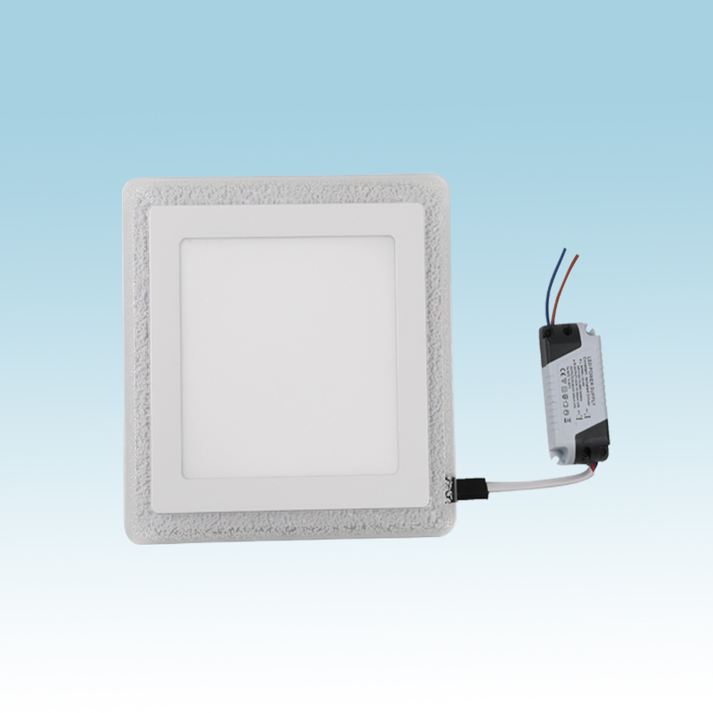
PL11
Material:Iron base+ PMMA Cover
Input Voltage:AC85-265V
Led Chip:2835SMD
IP Rating:IP44 CRI>80 PF>0.9
Color Temperature:3000K/4500K/6000K
Operating Temperature:-25℃ ~50℃
Life Span:50000hours
Certificate:CE ROHS
Item Number | Wattage | Led Quantity | Luminous Flux | Beam Angle | Size (mm)
PL11 | 3+3W | 12pcs2835SMD | 480-540lm | 120° | 105*105
 | 6+3W | 24pcs2835SMD | 960-1080lm | 120° | 145*145
 | 12+6W | 36pcs2835SMD | 1440-1620lm | 120° | 195*195
 | 18+6W | 48pcs2835SMD | 1920-2160lm | 120° | 240*240
Modern Ceiling Light Material:Iron base+ PMMA Cover Input Voltage:AC85-265V Led Chip:2835SMD IP Rating:IP44 CRI>80 PF>0.9 Color Temperature:3000K/4500K/6000K Operating Temperature:-25℃ ~50℃ Life Span:50000hours Certificate:CE ROHS
Item Number | Wattage | LedQuantity | LuminousFlux | Beam Angle | Size (mm) | WIFI Control Remte control Switch control Dimmer control
CL-N00 | 24W | 48pcs2835SMD | 1920-2160lm | 120° | 350mm | Yes
 | 36W | 72pcs2835SMD | 2880-3240lm | 120° | 400mm
 | 40W | 80pcs2835SMD | 3200-3600lm | 120° | 450mm
Modern Ceiling Light Material:Iron base+ PMMA Cover Input Voltage:AC85-265V Led Chip:2835SMD IP Rating:IP44 CRI>80 PF>0.9 Color Temperature:3000K/4500K/6000K Operating Temperature:-25℃ ~50℃ Life Span:50000hours Certificate:CE ROHS
Item Number | Wattage | LedQuantity | LuminousFlux | Beam Angle | Size (mm) | WIFI Control Remte control Switch control Dimmer control
CL-N00 | 24W | 48pcs2835SMD | 1920-2160lm | 120° | 350mm | Yes
 | 36W | 72pcs2835SMD | 2880-3240lm | 120° | 400mm
 | 40W | 80pcs2835SMD | 3200-3600lm | 120° | 450mm
Modern Ceiling Light Material:Iron base+ PMMA Cover Input Voltage:AC85-265V Led Chip:2835SMD IP Rating:IP44 CRI>80 PF>0.9 Color Temperature:3000K/4500K/6000K Operating Temperature:-25℃ ~50℃ Life Span:50000hours Certificate:CE ROHS
Item Number | Wattage | LedQuantity | LuminousFlux | Beam Angle | Size (mm) | WIFI Control Remte control Switch control Dimmer control
CL-N00 | 24W | 48pcs2835SMD | 1920-2160lm | 120° | 350mm | Yes
 | 36W | 72pcs2835SMD | 2880-3240lm | 120° | 400mm
 | 40W | 80pcs2835SMD | 3200-3600lm | 120° | 450mm
Modern Ceiling Light Material:Iron base+ PMMA Cover Input Voltage:AC85-265V Led Chip:2835SMD IP Rating:IP44 CRI>80 PF>0.9 Color Temperature:3000K/4500K/6000K Operating Temperature:-25℃ ~50℃ Life Span:50000hours Certificate:CE ROHS
Item Number | Wattage | LedQuantity | LuminousFlux | Beam Angle | Size (mm) | WIFI Control Remte control Switch control Dimmer control
CL-N00 | 24W | 48pcs2835SMD | 1920-2160lm | 120° | 350mm | Yes
 | 36W | 72pcs2835SMD | 2880-3240lm | 120° | 400mm
 | 40W | 80pcs2835SMD | 3200-3600lm | 120° | 450mm

Slide 20
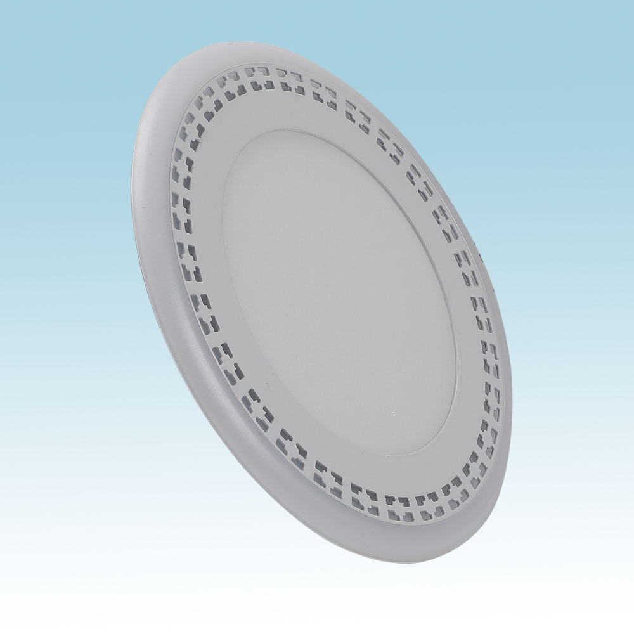
PL12
Material:Iron base+ PMMA Cover
Input Voltage:AC85-265V
Led Chip:2835SMD
IP Rating:IP44 CRI>80 PF>0.9
Color Temperature:3000K/4500K/6000K
Operating Temperature:-25℃ ~50℃
Life Span:50000hours
Certificate:CE ROHS
Item Number | Wattage | Led Quantity | Luminous Flux | Beam Angle | Size (mm)
PL12 | 3+3W | 12pcs2835SMD | 480-540lm | 120° | Φ105
 | 6+3W | 24pcs2835SMD | 960-1080lm | 120° | Φ145
 | 12+6W | 36pcs2835SMD | 1440-1620lm | 120° | Φ195
 | 18+6W | 48pcs2835SMD | 1920-2160lm | 120° | Φ240
Modern Ceiling Light Material:Iron base+ PMMA Cover Input Voltage:AC85-265V Led Chip:2835SMD IP Rating:IP44 CRI>80 PF>0.9 Color Temperature:3000K/4500K/6000K Operating Temperature:-25℃ ~50℃ Life Span:50000hours Certificate:CE ROHS
Item Number | Wattage | LedQuantity | LuminousFlux | Beam Angle | Size (mm) | WIFI Control Remte control Switch control Dimmer control
CL-N00 | 24W | 48pcs2835SMD | 1920-2160lm | 120° | 350mm | Yes
 | 36W | 72pcs2835SMD | 2880-3240lm | 120° | 400mm
 | 40W | 80pcs2835SMD | 3200-3600lm | 120° | 450mm
Modern Ceiling Light Material:Iron base+ PMMA Cover Input Voltage:AC85-265V Led Chip:2835SMD IP Rating:IP44 CRI>80 PF>0.9 Color Temperature:3000K/4500K/6000K Operating Temperature:-25℃ ~50℃ Life Span:50000hours Certificate:CE ROHS
Item Number | Wattage | LedQuantity | LuminousFlux | Beam Angle | Size (mm) | WIFI Control Remte control Switch control Dimmer control
CL-N00 | 24W | 48pcs2835SMD | 1920-2160lm | 120° | 350mm | Yes
 | 36W | 72pcs2835SMD | 2880-3240lm | 120° | 400mm
 | 40W | 80pcs2835SMD | 3200-3600lm | 120° | 450mm
Modern Ceiling Light Material:Iron base+ PMMA Cover Input Voltage:AC85-265V Led Chip:2835SMD IP Rating:IP44 CRI>80 PF>0.9 Color Temperature:3000K/4500K/6000K Operating Temperature:-25℃ ~50℃ Life Span:50000hours Certificate:CE ROHS
Item Number | Wattage | LedQuantity | LuminousFlux | Beam Angle | Size (mm) | WIFI Control Remte control Switch control Dimmer control
CL-N00 | 24W | 48pcs2835SMD | 1920-2160lm | 120° | 350mm | Yes
 | 36W | 72pcs2835SMD | 2880-3240lm | 120° | 400mm
 | 40W | 80pcs2835SMD | 3200-3600lm | 120° | 450mm
Modern Ceiling Light Material:Iron base+ PMMA Cover Input Voltage:AC85-265V Led Chip:2835SMD IP Rating:IP44 CRI>80 PF>0.9 Color Temperature:3000K/4500K/6000K Operating Temperature:-25℃ ~50℃ Life Span:50000hours Certificate:CE ROHS
Item Number | Wattage | LedQuantity | LuminousFlux | Beam Angle | Size (mm) | WIFI Control Remte control Switch control Dimmer control
CL-N00 | 24W | 48pcs2835SMD | 1920-2160lm | 120° | 350mm | Yes
 | 36W | 72pcs2835SMD | 2880-3240lm | 120° | 400mm
 | 40W | 80pcs2835SMD | 3200-3600lm | 120° | 450mm

Slide 21
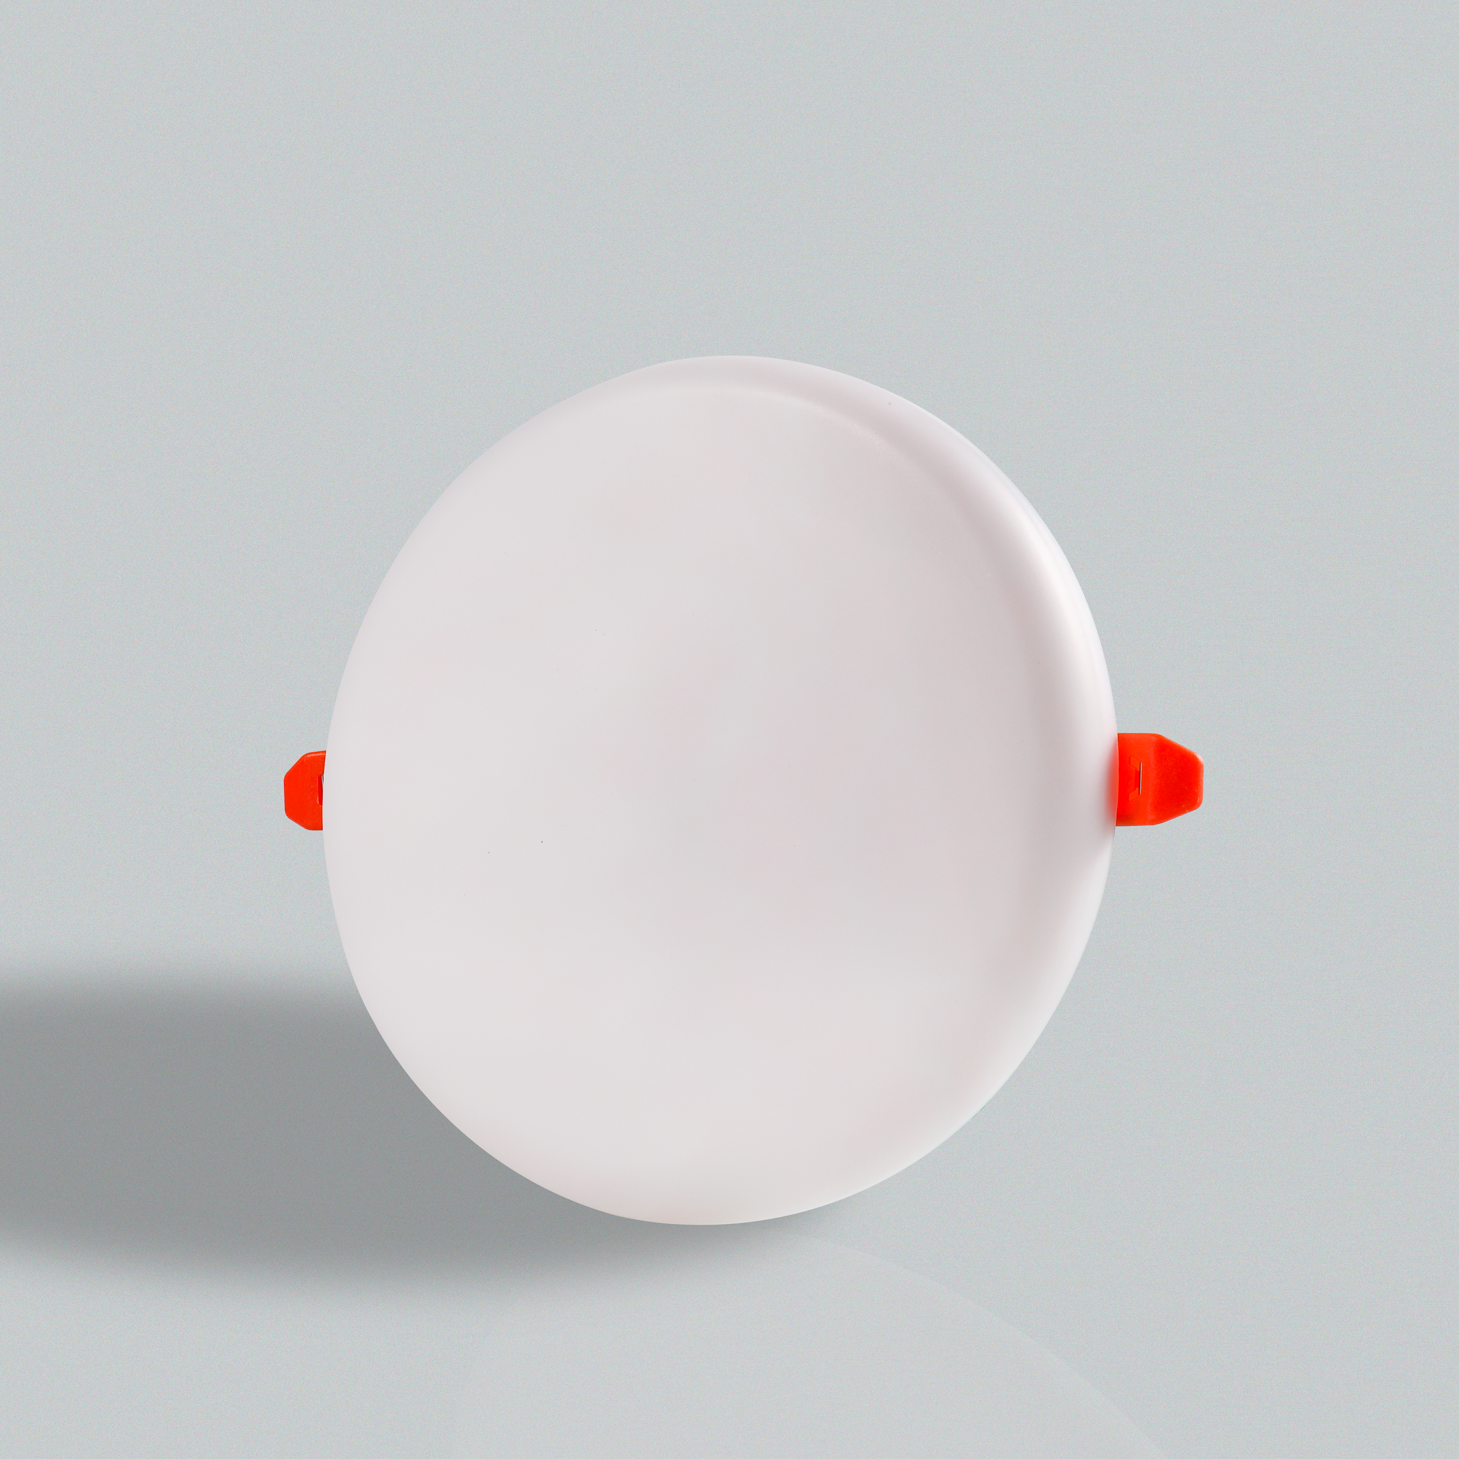
PL-N01R
Frameless panel light
Material:Aluminum+PMMA/PS/MS Cover
Input Voltage:AC85- 265V
Led Chip:2835SMD
Chip Brand :Epistar
IP Rating:IP44 CRI>80 PF>0.9
Color Temperature:3000K/4500K/6000K
Operating Temperature:-20℃ -50℃
Life Span：50000hours
Certificate：CE,ROHS
Item Number | Wattage | Led Quantity | Luminous Flux | Beam Angle | Size (mm) | Open size（mm）
PL-N01R | 9W | 18pcs 2835SMD | 720-810lm | 120° | φ93 | 50-80
 | 18W | 36pcs 2835SMD | 1440-1620lm | 120° | φ123 | 50-110
 | 24W | 48pcs 2835SMD | 1920-2160lm | 120° | φ175 | 75-160
 | 36W | 72pcs 2835SMD | 2880-3240lm | 120° | φ228 | 75-210
Modern Ceiling Light Material:Iron base+ PMMA Cover Input Voltage:AC85-265V Led Chip:2835SMD IP Rating:IP44 CRI>80 PF>0.9 Color Temperature:3000K/4500K/6000K Operating Temperature:-25℃ ~50℃ Life Span:50000hours Certificate:CE ROHS
Item Number | Wattage | LedQuantity | LuminousFlux | Beam Angle | Size (mm) | WIFI Control Remte control Switch control Dimmer control
CL-N00 | 24W | 48pcs2835SMD | 1920-2160lm | 120° | 350mm | Yes
 | 36W | 72pcs2835SMD | 2880-3240lm | 120° | 400mm
 | 40W | 80pcs2835SMD | 3200-3600lm | 120° | 450mm
Modern Ceiling Light Material:Iron base+ PMMA Cover Input Voltage:AC85-265V Led Chip:2835SMD IP Rating:IP44 CRI>80 PF>0.9 Color Temperature:3000K/4500K/6000K Operating Temperature:-25℃ ~50℃ Life Span:50000hours Certificate:CE ROHS
Item Number | Wattage | LedQuantity | LuminousFlux | Beam Angle | Size (mm) | WIFI Control Remte control Switch control Dimmer control
CL-N00 | 24W | 48pcs2835SMD | 1920-2160lm | 120° | 350mm | Yes
 | 36W | 72pcs2835SMD | 2880-3240lm | 120° | 400mm
 | 40W | 80pcs2835SMD | 3200-3600lm | 120° | 450mm
Modern Ceiling Light Material:Iron base+ PMMA Cover Input Voltage:AC85-265V Led Chip:2835SMD IP Rating:IP44 CRI>80 PF>0.9 Color Temperature:3000K/4500K/6000K Operating Temperature:-25℃ ~50℃ Life Span:50000hours Certificate:CE ROHS
Item Number | Wattage | LedQuantity | LuminousFlux | Beam Angle | Size (mm) | WIFI Control Remte control Switch control Dimmer control
CL-N00 | 24W | 48pcs2835SMD | 1920-2160lm | 120° | 350mm | Yes
 | 36W | 72pcs2835SMD | 2880-3240lm | 120° | 400mm
 | 40W | 80pcs2835SMD | 3200-3600lm | 120° | 450mm
Modern Ceiling Light Material:Iron base+ PMMA Cover Input Voltage:AC85-265V Led Chip:2835SMD IP Rating:IP44 CRI>80 PF>0.9 Color Temperature:3000K/4500K/6000K Operating Temperature:-25℃ ~50℃ Life Span:50000hours Certificate:CE ROHS
Item Number | Wattage | LedQuantity | LuminousFlux | Beam Angle | Size (mm) | WIFI Control Remte control Switch control Dimmer control
CL-N00 | 24W | 48pcs2835SMD | 1920-2160lm | 120° | 350mm | Yes
 | 36W | 72pcs2835SMD | 2880-3240lm | 120° | 400mm
 | 40W | 80pcs2835SMD | 3200-3600lm | 120° | 450mm

Slide 22
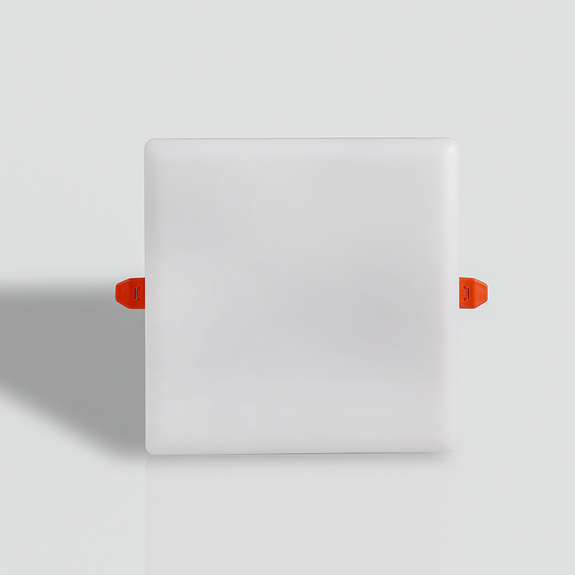
PL-N01S
Frameless panel light
Material:Aluminum+PMMA/PS/MS Cover
Input Voltage:AC85- 265V
Led Chip:2835SMD
Chip Brand :Epistar
IP Rating:IP44 CRI>80 PF>0.9
Color Temperature:3000K/4500K/6000K
Operating Temperature:-20℃ -50℃
Life Span：50000hours
Certificate：CE,ROHS
Item Number | Wattage | Led Quantity | Luminous Flux | Beam Angle | Size (mm) | Open size（mm）
PL-N01S | 9W | 18pcs 2835SMD | 720-810lm | 120° | φ93 | 50-80
 | 18W | 36pcs 2835SMD | 1440-1620lm | 120° | φ123 | 50-110
 | 24W | 48pcs 2835SMD | 1920-2160lm | 120° | φ175 | 75-160
 | 36W | 72pcs 2835SMD | 2880-3240lm | 120° | φ228 | 75-210
Modern Ceiling Light Material:Iron base+ PMMA Cover Input Voltage:AC85-265V Led Chip:2835SMD IP Rating:IP44 CRI>80 PF>0.9 Color Temperature:3000K/4500K/6000K Operating Temperature:-25℃ ~50℃ Life Span:50000hours Certificate:CE ROHS
Item Number | Wattage | LedQuantity | LuminousFlux | Beam Angle | Size (mm) | WIFI Control Remte control Switch control Dimmer control
CL-N00 | 24W | 48pcs2835SMD | 1920-2160lm | 120° | 350mm | Yes
 | 36W | 72pcs2835SMD | 2880-3240lm | 120° | 400mm
 | 40W | 80pcs2835SMD | 3200-3600lm | 120° | 450mm
Modern Ceiling Light Material:Iron base+ PMMA Cover Input Voltage:AC85-265V Led Chip:2835SMD IP Rating:IP44 CRI>80 PF>0.9 Color Temperature:3000K/4500K/6000K Operating Temperature:-25℃ ~50℃ Life Span:50000hours Certificate:CE ROHS
Item Number | Wattage | LedQuantity | LuminousFlux | Beam Angle | Size (mm) | WIFI Control Remte control Switch control Dimmer control
CL-N00 | 24W | 48pcs2835SMD | 1920-2160lm | 120° | 350mm | Yes
 | 36W | 72pcs2835SMD | 2880-3240lm | 120° | 400mm
 | 40W | 80pcs2835SMD | 3200-3600lm | 120° | 450mm
Modern Ceiling Light Material:Iron base+ PMMA Cover Input Voltage:AC85-265V Led Chip:2835SMD IP Rating:IP44 CRI>80 PF>0.9 Color Temperature:3000K/4500K/6000K Operating Temperature:-25℃ ~50℃ Life Span:50000hours Certificate:CE ROHS
Item Number | Wattage | LedQuantity | LuminousFlux | Beam Angle | Size (mm) | WIFI Control Remte control Switch control Dimmer control
CL-N00 | 24W | 48pcs2835SMD | 1920-2160lm | 120° | 350mm | Yes
 | 36W | 72pcs2835SMD | 2880-3240lm | 120° | 400mm
 | 40W | 80pcs2835SMD | 3200-3600lm | 120° | 450mm
Modern Ceiling Light Material:Iron base+ PMMA Cover Input Voltage:AC85-265V Led Chip:2835SMD IP Rating:IP44 CRI>80 PF>0.9 Color Temperature:3000K/4500K/6000K Operating Temperature:-25℃ ~50℃ Life Span:50000hours Certificate:CE ROHS
Item Number | Wattage | LedQuantity | LuminousFlux | Beam Angle | Size (mm) | WIFI Control Remte control Switch control Dimmer control
CL-N00 | 24W | 48pcs2835SMD | 1920-2160lm | 120° | 350mm | Yes
 | 36W | 72pcs2835SMD | 2880-3240lm | 120° | 400mm
 | 40W | 80pcs2835SMD | 3200-3600lm | 120° | 450mm

Slide 23
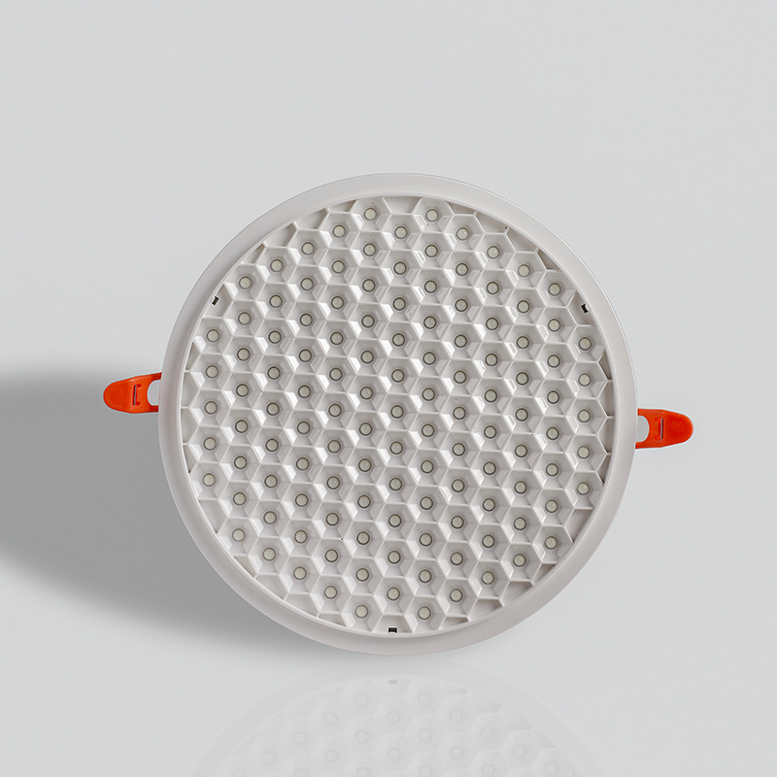
PL-N03
Frameless panel light
Material:Aluminum+PMMA/PS/MS Cover
Input Voltage:AC85- 265V
Led Chip:2835SMD
Chip Brand :Epistar
IP Rating:IP44 CRI>80 PF>0.9
Color Temperature:3000K/4500K/6000K
Operating Temperature:-20℃ -50℃
Life Span：50000hours
Certificate：CE,ROHS
Item Number | Wattage | Led Quantity | Luminous Flux | Beam Angle | Size (mm) | Open size（mm）
PL-N03 | 8W | 16pcs 2835SMD | 640-720lm | 120° | φ85 | 50-80
 | 15W | 30pcs 2835SMD | 1200-1440lm | 120° | φ120 | 50-100
 | 22W | 44pcs 2835SMD | 1760-1980lm | 120° | φ170 | 50-150
 | 32W | 64pcs 2835SMD | 2560-2880lm | 120° | φ220 | 50-200
Modern Ceiling Light Material:Iron base+ PMMA Cover Input Voltage:AC85-265V Led Chip:2835SMD IP Rating:IP44 CRI>80 PF>0.9 Color Temperature:3000K/4500K/6000K Operating Temperature:-25℃ ~50℃ Life Span:50000hours Certificate:CE ROHS
Item Number | Wattage | LedQuantity | LuminousFlux | Beam Angle | Size (mm) | WIFI Control Remte control Switch control Dimmer control
CL-N00 | 24W | 48pcs2835SMD | 1920-2160lm | 120° | 350mm | Yes
 | 36W | 72pcs2835SMD | 2880-3240lm | 120° | 400mm
 | 40W | 80pcs2835SMD | 3200-3600lm | 120° | 450mm
Modern Ceiling Light Material:Iron base+ PMMA Cover Input Voltage:AC85-265V Led Chip:2835SMD IP Rating:IP44 CRI>80 PF>0.9 Color Temperature:3000K/4500K/6000K Operating Temperature:-25℃ ~50℃ Life Span:50000hours Certificate:CE ROHS
Item Number | Wattage | LedQuantity | LuminousFlux | Beam Angle | Size (mm) | WIFI Control Remte control Switch control Dimmer control
CL-N00 | 24W | 48pcs2835SMD | 1920-2160lm | 120° | 350mm | Yes
 | 36W | 72pcs2835SMD | 2880-3240lm | 120° | 400mm
 | 40W | 80pcs2835SMD | 3200-3600lm | 120° | 450mm
Modern Ceiling Light Material:Iron base+ PMMA Cover Input Voltage:AC85-265V Led Chip:2835SMD IP Rating:IP44 CRI>80 PF>0.9 Color Temperature:3000K/4500K/6000K Operating Temperature:-25℃ ~50℃ Life Span:50000hours Certificate:CE ROHS
Item Number | Wattage | LedQuantity | LuminousFlux | Beam Angle | Size (mm) | WIFI Control Remte control Switch control Dimmer control
CL-N00 | 24W | 48pcs2835SMD | 1920-2160lm | 120° | 350mm | Yes
 | 36W | 72pcs2835SMD | 2880-3240lm | 120° | 400mm
 | 40W | 80pcs2835SMD | 3200-3600lm | 120° | 450mm
Modern Ceiling Light Material:Iron base+ PMMA Cover Input Voltage:AC85-265V Led Chip:2835SMD IP Rating:IP44 CRI>80 PF>0.9 Color Temperature:3000K/4500K/6000K Operating Temperature:-25℃ ~50℃ Life Span:50000hours Certificate:CE ROHS
Item Number | Wattage | LedQuantity | LuminousFlux | Beam Angle | Size (mm) | WIFI Control Remte control Switch control Dimmer control
CL-N00 | 24W | 48pcs2835SMD | 1920-2160lm | 120° | 350mm | Yes
 | 36W | 72pcs2835SMD | 2880-3240lm | 120° | 400mm
 | 40W | 80pcs2835SMD | 3200-3600lm | 120° | 450mm

Slide 24
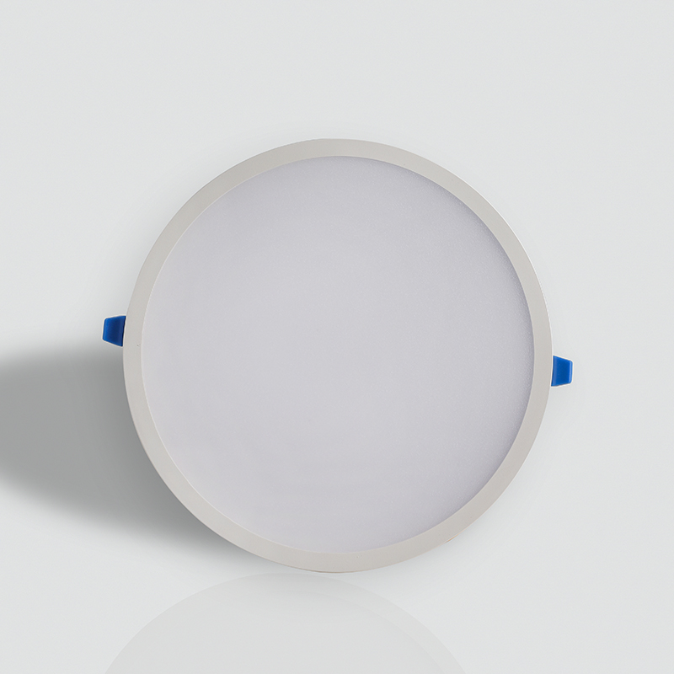
PL-N02R
Frameless panel light
Material:Aluminum+PMMA/PS/MS Cover
Input Voltage:AC85- 265V
Led Chip:2835SMD
Chip Brand :Epistar
IP Rating:IP44 CRI>80 PF>0.9
Color Temperature:3000K/4500K/6000K
Operating Temperature:-20℃ -50℃
Life Span：50000hours
Certificate：CE,ROHS
Item Number | Wattage | Led Quantity | Luminous Flux | Beam Angle | Size (mm) | Open size（mm）
PL-N02 | 9W | 18pcs 2835SMD | 720-810lm | 120° | 93*93 | 50-80
 | 18W | 36pcs 2835SMD | 1440-1620lm | 120° | 123*123 | 50-110
 | 24W | 48pcs 2835SMD | 1920-2160lm | 120° | 175*175 | 75-160
 | 36W | 72pcs 2835SMD | 2880-3240lm | 120° | 228*228 | 75-210
Modern Ceiling Light Material:Iron base+ PMMA Cover Input Voltage:AC85-265V Led Chip:2835SMD IP Rating:IP44 CRI>80 PF>0.9 Color Temperature:3000K/4500K/6000K Operating Temperature:-25℃ ~50℃ Life Span:50000hours Certificate:CE ROHS
Item Number | Wattage | LedQuantity | LuminousFlux | Beam Angle | Size (mm) | WIFI Control Remte control Switch control Dimmer control
CL-N00 | 24W | 48pcs2835SMD | 1920-2160lm | 120° | 350mm | Yes
 | 36W | 72pcs2835SMD | 2880-3240lm | 120° | 400mm
 | 40W | 80pcs2835SMD | 3200-3600lm | 120° | 450mm
Modern Ceiling Light Material:Iron base+ PMMA Cover Input Voltage:AC85-265V Led Chip:2835SMD IP Rating:IP44 CRI>80 PF>0.9 Color Temperature:3000K/4500K/6000K Operating Temperature:-25℃ ~50℃ Life Span:50000hours Certificate:CE ROHS
Item Number | Wattage | LedQuantity | LuminousFlux | Beam Angle | Size (mm) | WIFI Control Remte control Switch control Dimmer control
CL-N00 | 24W | 48pcs2835SMD | 1920-2160lm | 120° | 350mm | Yes
 | 36W | 72pcs2835SMD | 2880-3240lm | 120° | 400mm
 | 40W | 80pcs2835SMD | 3200-3600lm | 120° | 450mm
Modern Ceiling Light Material:Iron base+ PMMA Cover Input Voltage:AC85-265V Led Chip:2835SMD IP Rating:IP44 CRI>80 PF>0.9 Color Temperature:3000K/4500K/6000K Operating Temperature:-25℃ ~50℃ Life Span:50000hours Certificate:CE ROHS
Item Number | Wattage | LedQuantity | LuminousFlux | Beam Angle | Size (mm) | WIFI Control Remte control Switch control Dimmer control
CL-N00 | 24W | 48pcs2835SMD | 1920-2160lm | 120° | 350mm | Yes
 | 36W | 72pcs2835SMD | 2880-3240lm | 120° | 400mm
 | 40W | 80pcs2835SMD | 3200-3600lm | 120° | 450mm
Modern Ceiling Light Material:Iron base+ PMMA Cover Input Voltage:AC85-265V Led Chip:2835SMD IP Rating:IP44 CRI>80 PF>0.9 Color Temperature:3000K/4500K/6000K Operating Temperature:-25℃ ~50℃ Life Span:50000hours Certificate:CE ROHS
Item Number | Wattage | LedQuantity | LuminousFlux | Beam Angle | Size (mm) | WIFI Control Remte control Switch control Dimmer control
CL-N00 | 24W | 48pcs2835SMD | 1920-2160lm | 120° | 350mm | Yes
 | 36W | 72pcs2835SMD | 2880-3240lm | 120° | 400mm
 | 40W | 80pcs2835SMD | 3200-3600lm | 120° | 450mm

Slide 25
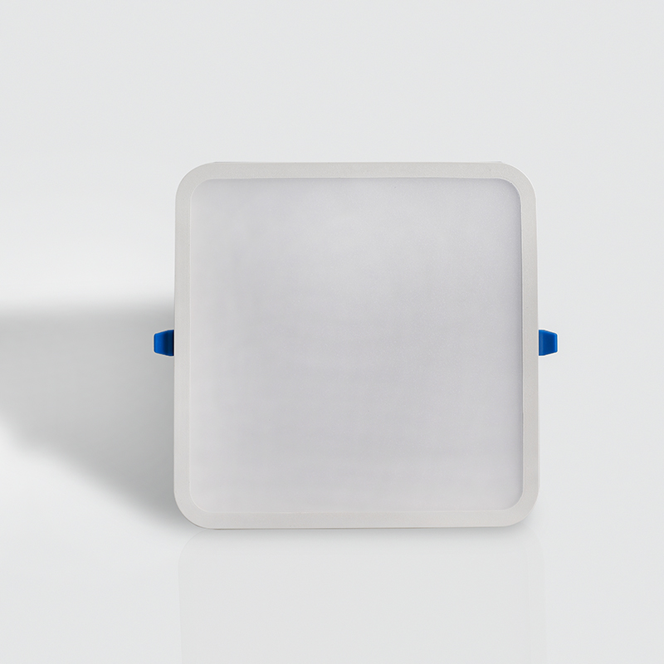
PL-N02S
Frameless panel light
Material:Aluminum+PMMA/PS/MS Cover
Input Voltage:AC85- 265V
Led Chip:2835SMD
Chip Brand :Epistar
IP Rating:IP44 CRI>80 PF>0.9
Color Temperature:3000K/4500K/6000K
Operating Temperature:-20℃ -50℃
Life Span：50000hours
Certificate：CE,ROHS
Item Number | Wattage | Led Quantity | Luminous Flux | Beam Angle | Size (mm) | Open size（mm）
PL-N02 | 9W | 18pcs 2835SMD | 720-810lm | 120° | 93*93 | 50-80
 | 18W | 36pcs 2835SMD | 1440-1620lm | 120° | 123*123 | 50-110
 | 24W | 48pcs 2835SMD | 1920-2160lm | 120° | 175*175 | 75-160
 | 36W | 72pcs 2835SMD | 2880-3240lm | 120° | 228*228 | 75-210
Modern Ceiling Light Material:Iron base+ PMMA Cover Input Voltage:AC85-265V Led Chip:2835SMD IP Rating:IP44 CRI>80 PF>0.9 Color Temperature:3000K/4500K/6000K Operating Temperature:-25℃ ~50℃ Life Span:50000hours Certificate:CE ROHS
Item Number | Wattage | LedQuantity | LuminousFlux | Beam Angle | Size (mm) | WIFI Control Remte control Switch control Dimmer control
CL-N00 | 24W | 48pcs2835SMD | 1920-2160lm | 120° | 350mm | Yes
 | 36W | 72pcs2835SMD | 2880-3240lm | 120° | 400mm
 | 40W | 80pcs2835SMD | 3200-3600lm | 120° | 450mm
Modern Ceiling Light Material:Iron base+ PMMA Cover Input Voltage:AC85-265V Led Chip:2835SMD IP Rating:IP44 CRI>80 PF>0.9 Color Temperature:3000K/4500K/6000K Operating Temperature:-25℃ ~50℃ Life Span:50000hours Certificate:CE ROHS
Item Number | Wattage | LedQuantity | LuminousFlux | Beam Angle | Size (mm) | WIFI Control Remte control Switch control Dimmer control
CL-N00 | 24W | 48pcs2835SMD | 1920-2160lm | 120° | 350mm | Yes
 | 36W | 72pcs2835SMD | 2880-3240lm | 120° | 400mm
 | 40W | 80pcs2835SMD | 3200-3600lm | 120° | 450mm
Modern Ceiling Light Material:Iron base+ PMMA Cover Input Voltage:AC85-265V Led Chip:2835SMD IP Rating:IP44 CRI>80 PF>0.9 Color Temperature:3000K/4500K/6000K Operating Temperature:-25℃ ~50℃ Life Span:50000hours Certificate:CE ROHS
Item Number | Wattage | LedQuantity | LuminousFlux | Beam Angle | Size (mm) | WIFI Control Remte control Switch control Dimmer control
CL-N00 | 24W | 48pcs2835SMD | 1920-2160lm | 120° | 350mm | Yes
 | 36W | 72pcs2835SMD | 2880-3240lm | 120° | 400mm
 | 40W | 80pcs2835SMD | 3200-3600lm | 120° | 450mm
Modern Ceiling Light Material:Iron base+ PMMA Cover Input Voltage:AC85-265V Led Chip:2835SMD IP Rating:IP44 CRI>80 PF>0.9 Color Temperature:3000K/4500K/6000K Operating Temperature:-25℃ ~50℃ Life Span:50000hours Certificate:CE ROHS
Item Number | Wattage | LedQuantity | LuminousFlux | Beam Angle | Size (mm) | WIFI Control Remte control Switch control Dimmer control
CL-N00 | 24W | 48pcs2835SMD | 1920-2160lm | 120° | 350mm | Yes
 | 36W | 72pcs2835SMD | 2880-3240lm | 120° | 400mm
 | 40W | 80pcs2835SMD | 3200-3600lm | 120° | 450mm

Slide 26
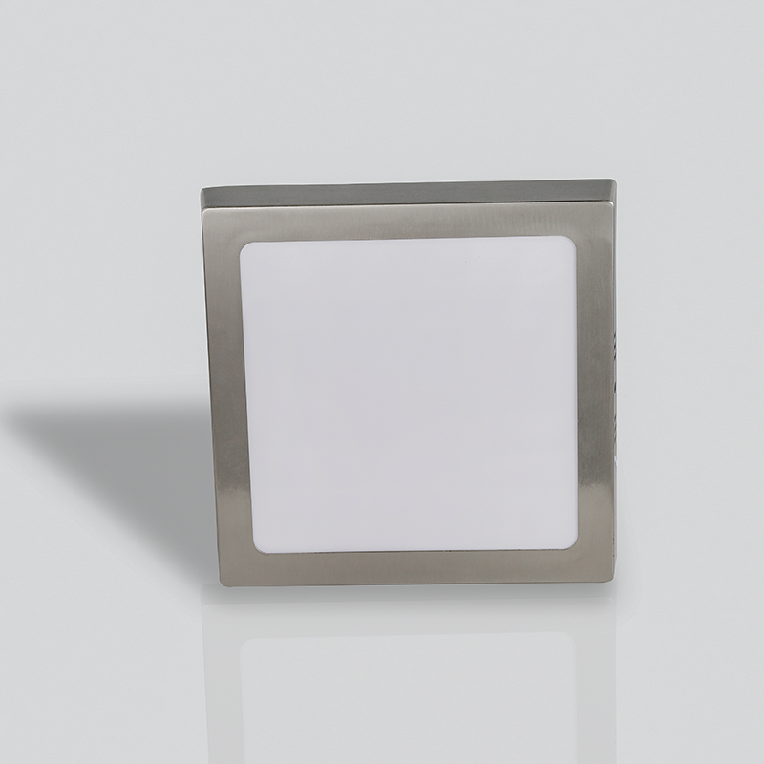
PL-N05
Frameless panel light
Material:Aluminum+PMMA/PS/MS Cover
Input Voltage:AC85- 265V
Led Chip:2835SMD
Chip Brand :Epistar
IP Rating:IP44 CRI>80 PF>0.9
Color Temperature:3000K/4500K/6000K
Operating Temperature:-20℃ -50℃
Life Span：50000hours
Certificate：CE,ROHS
Item Number | Wattage | Led Quantity | Luminous Flux | Beam Angle | Size (mm) | Open size（mm）
PL-N05 | 8W | 16pcs 2835SMD | 640-720lm | 120° | φ95 | 70
 | 12W | 24pcs 2835SMD | 960-1080lm | 120° | φ130 | 100
 | 18W | 36pcs 2835SMD | 1440-1620lm | 120° | φ185 | 160
 | 22W | 44pcs 2835SMD | 1760-1920lm | 120° | φ225 | 200
Modern Ceiling Light Material:Iron base+ PMMA Cover Input Voltage:AC85-265V Led Chip:2835SMD IP Rating:IP44 CRI>80 PF>0.9 Color Temperature:3000K/4500K/6000K Operating Temperature:-25℃ ~50℃ Life Span:50000hours Certificate:CE ROHS
Item Number | Wattage | LedQuantity | LuminousFlux | Beam Angle | Size (mm) | WIFI Control Remte control Switch control Dimmer control
CL-N00 | 24W | 48pcs2835SMD | 1920-2160lm | 120° | 350mm | Yes
 | 36W | 72pcs2835SMD | 2880-3240lm | 120° | 400mm
 | 40W | 80pcs2835SMD | 3200-3600lm | 120° | 450mm
Modern Ceiling Light Material:Iron base+ PMMA Cover Input Voltage:AC85-265V Led Chip:2835SMD IP Rating:IP44 CRI>80 PF>0.9 Color Temperature:3000K/4500K/6000K Operating Temperature:-25℃ ~50℃ Life Span:50000hours Certificate:CE ROHS
Item Number | Wattage | LedQuantity | LuminousFlux | Beam Angle | Size (mm) | WIFI Control Remte control Switch control Dimmer control
CL-N00 | 24W | 48pcs2835SMD | 1920-2160lm | 120° | 350mm | Yes
 | 36W | 72pcs2835SMD | 2880-3240lm | 120° | 400mm
 | 40W | 80pcs2835SMD | 3200-3600lm | 120° | 450mm
Modern Ceiling Light Material:Iron base+ PMMA Cover Input Voltage:AC85-265V Led Chip:2835SMD IP Rating:IP44 CRI>80 PF>0.9 Color Temperature:3000K/4500K/6000K Operating Temperature:-25℃ ~50℃ Life Span:50000hours Certificate:CE ROHS
Item Number | Wattage | LedQuantity | LuminousFlux | Beam Angle | Size (mm) | WIFI Control Remte control Switch control Dimmer control
CL-N00 | 24W | 48pcs2835SMD | 1920-2160lm | 120° | 350mm | Yes
 | 36W | 72pcs2835SMD | 2880-3240lm | 120° | 400mm
 | 40W | 80pcs2835SMD | 3200-3600lm | 120° | 450mm
Modern Ceiling Light Material:Iron base+ PMMA Cover Input Voltage:AC85-265V Led Chip:2835SMD IP Rating:IP44 CRI>80 PF>0.9 Color Temperature:3000K/4500K/6000K Operating Temperature:-25℃ ~50℃ Life Span:50000hours Certificate:CE ROHS
Item Number | Wattage | LedQuantity | LuminousFlux | Beam Angle | Size (mm) | WIFI Control Remte control Switch control Dimmer control
CL-N00 | 24W | 48pcs2835SMD | 1920-2160lm | 120° | 350mm | Yes
 | 36W | 72pcs2835SMD | 2880-3240lm | 120° | 400mm
 | 40W | 80pcs2835SMD | 3200-3600lm | 120° | 450mm

